Slide 1
Presentation on Android Project
CSE 2200
Advanced Programming Laboratory
Project: Bank Management System (KUET BANK)
Presented By:
Doniel Tripura
Roll: 1907121
Department of Computer Science and Engineering
Khulna University of Engineering & Technology

Slide 2
KUET BANK
Introduction
KUET BANK is mobile financial service of a demo bank, that allows a user to conduct financial transactions via the Internet.
Features:
Login system via email address and phone number.
Register system with email verification and OTP authentication.
Balance checking system.
Profile checking and edit system.
Transfer money from user to user.
Loan application and approval.
EMI payment system.
Customer List, Employee list & profile view.
Add money and Withdraw.
View Transaction History.
Add and remove employees.

Slide 3
Flow Chart of KUET BANK
Start
Perspective: Customer
Splash Screen
Menu
Login as Manager
Login as Customer
Login as Employee
Registered
Register
Login
Home Page
Check Balance
Profile
Edit Profile
Transfer
Loan
Sign Out
End

Slide 4
Flow Chart of KUET BANK
Start
Perspective: Employee
Splash Screen
Menu
Login as Manager
Login as Customer
Login as Employee
Registered
Login
Register
Home Page
Sign Out
View Profile
Customer List
Add Money
Edit Profile
Profile
Transfer
Notification
Withdraw
Transaction History
End

Slide 5
Flow Chart of KUET BANK
Perspective: Manager/Admin
Start
Splash Screen
Menu
Login as Manager
Login as Customer
Login as Employee
Login
Home Page
Profile
Edit Profile
Employee List
Add Employee
Sign Out
End

Slide 6
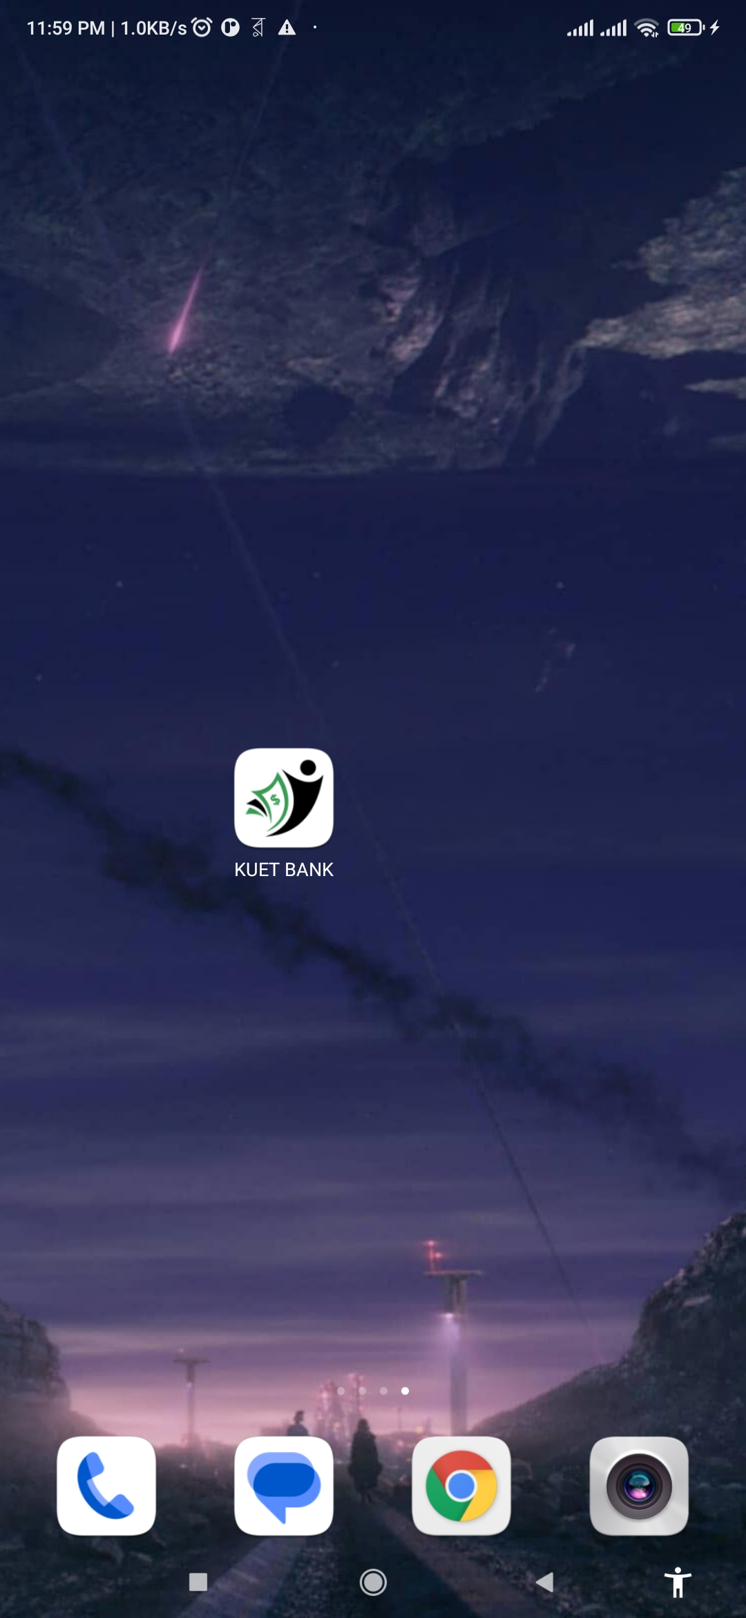

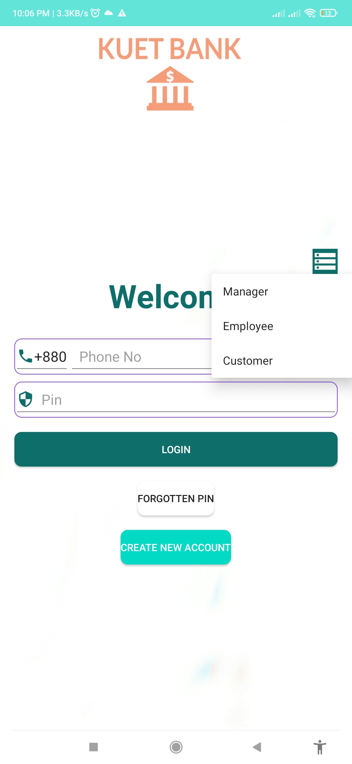
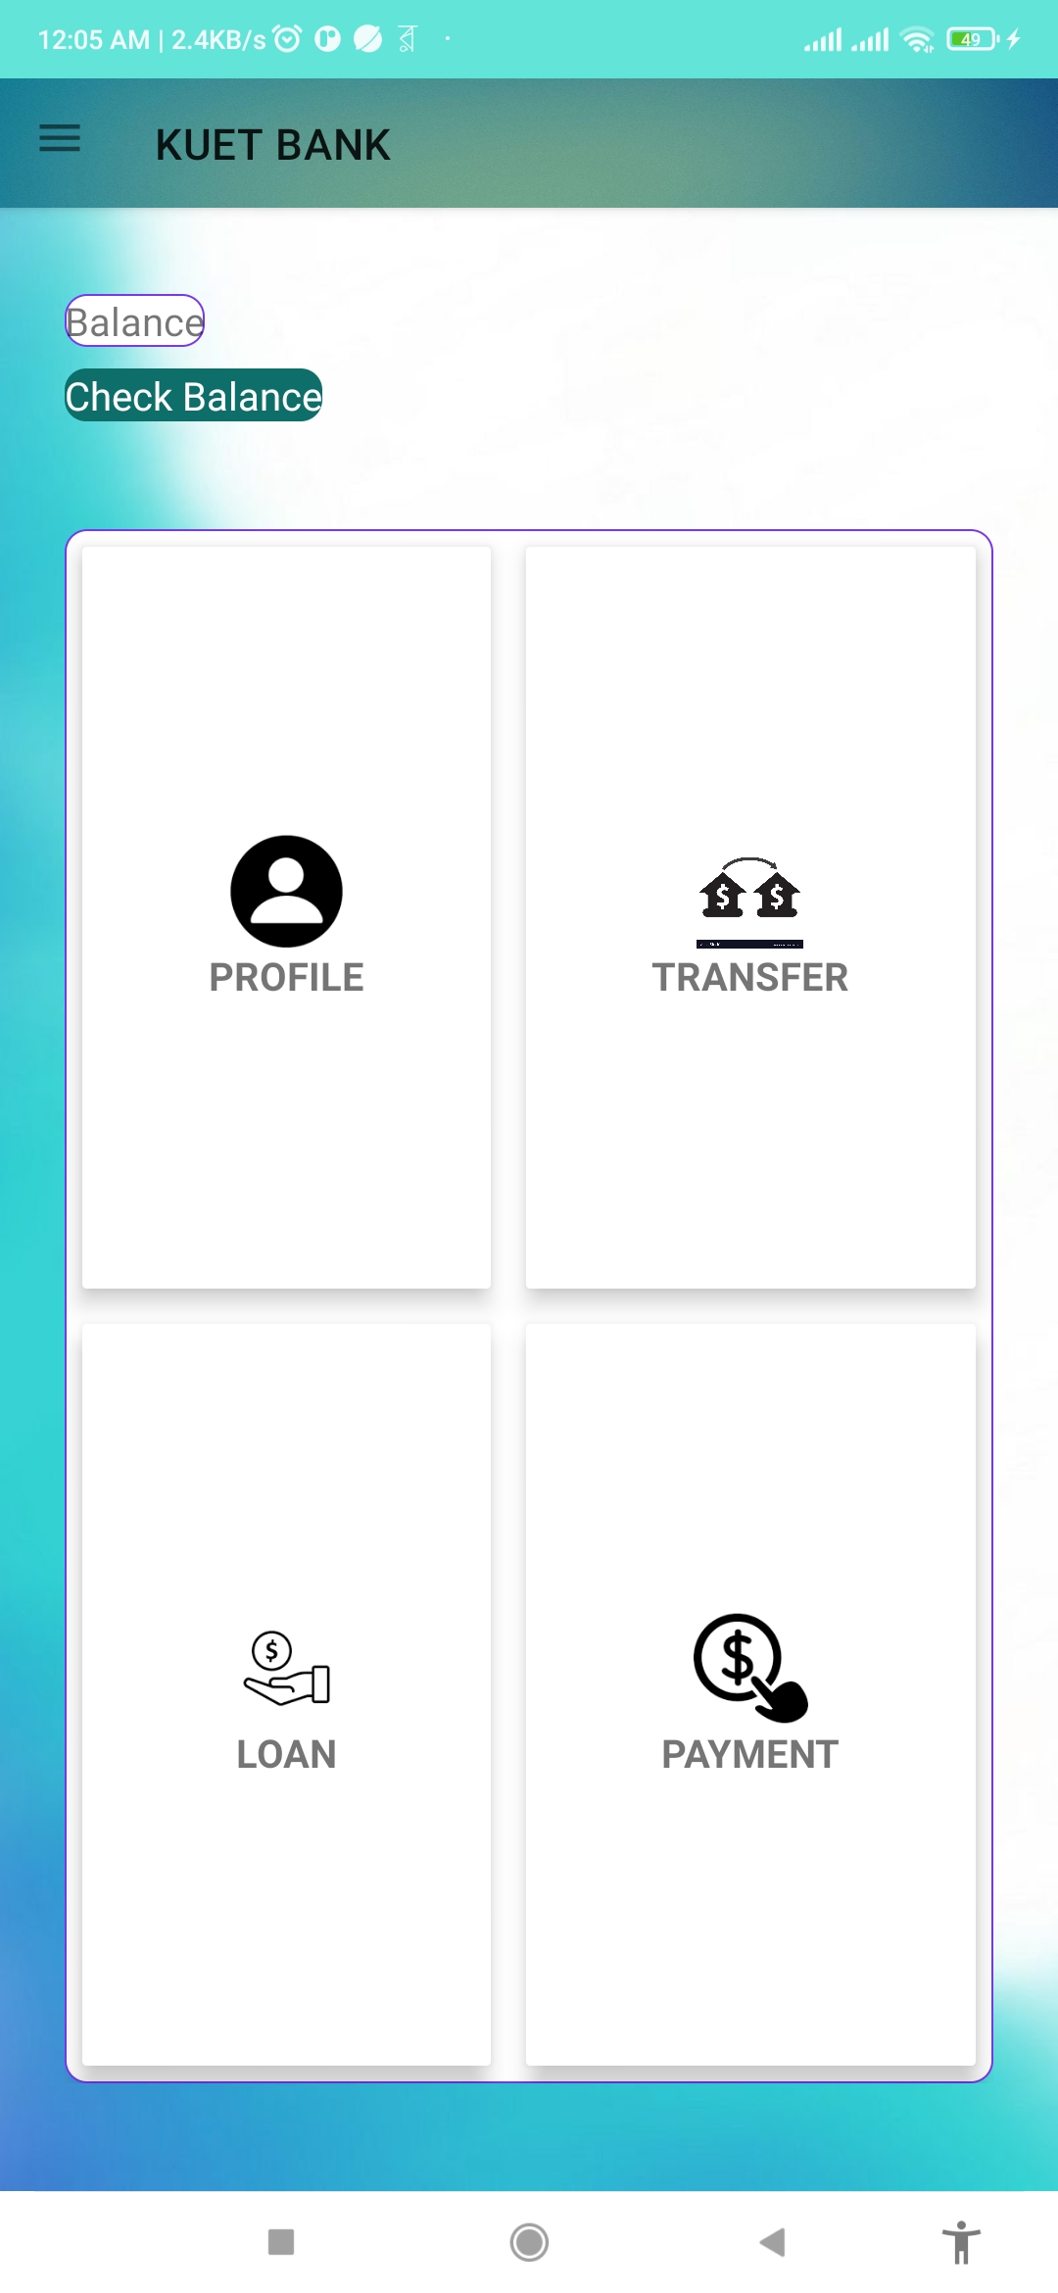
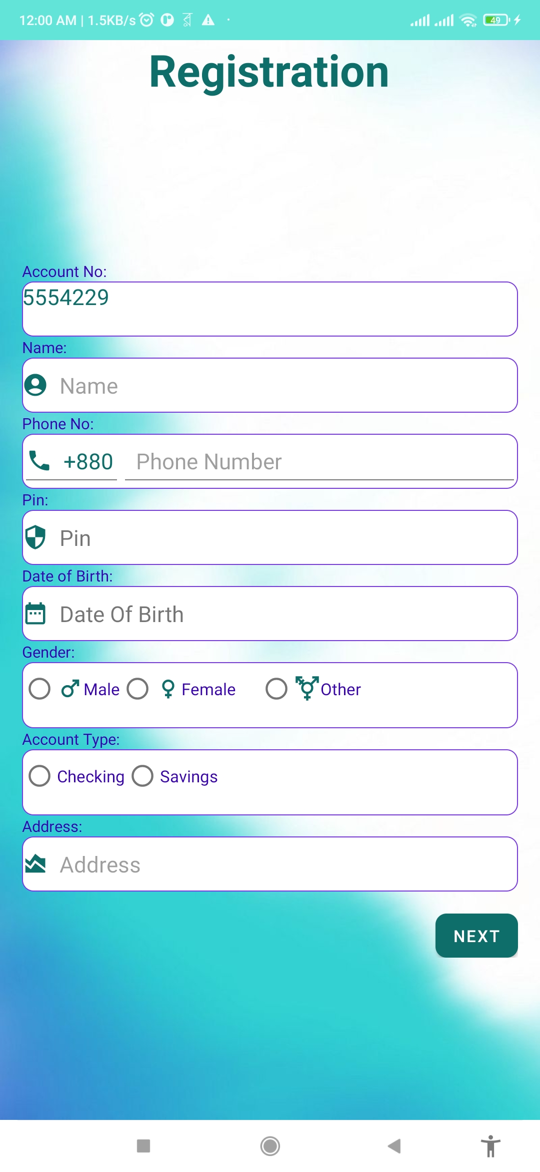
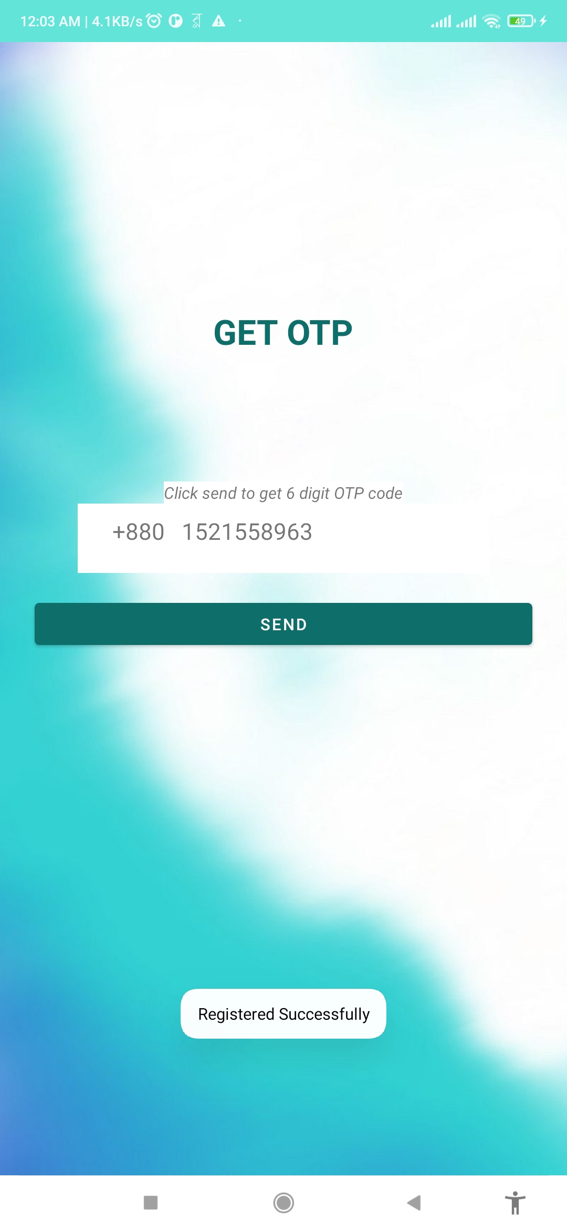
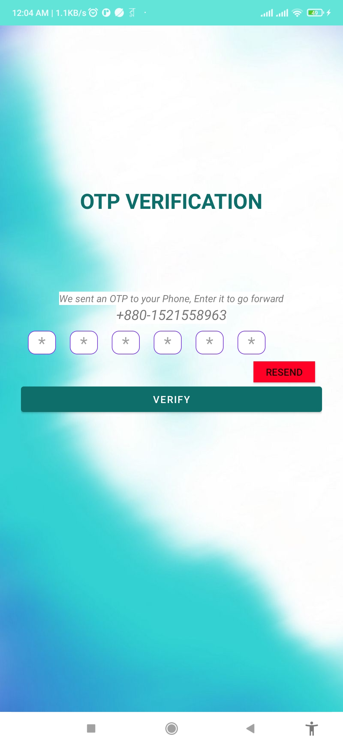
Visualization of Customer Panel

Slide 7
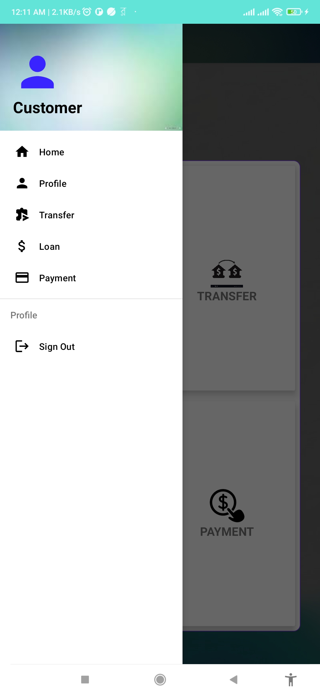
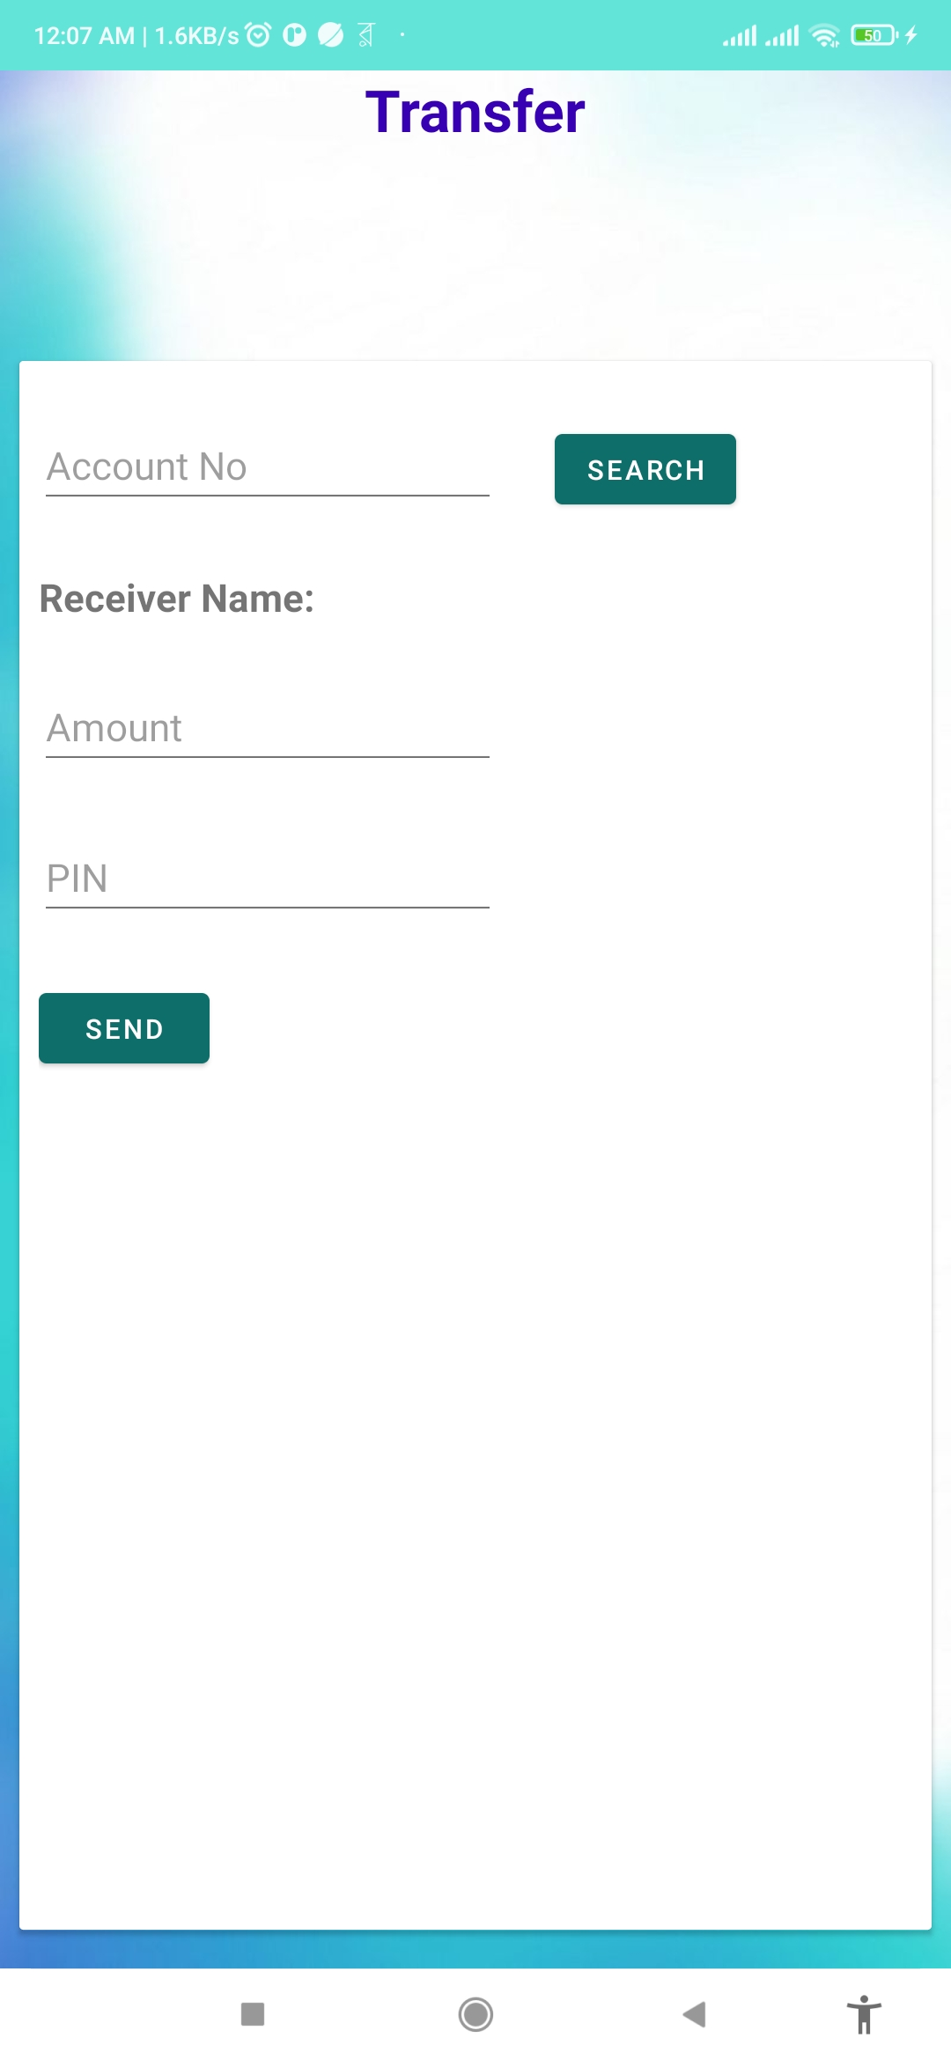
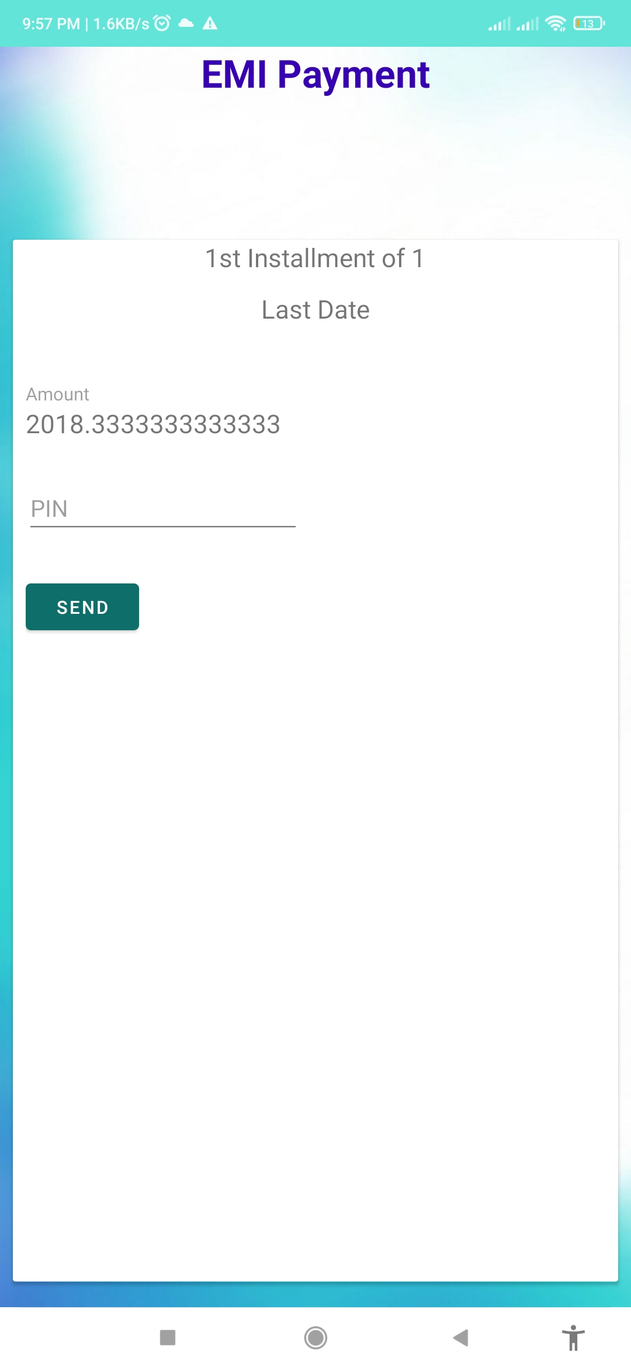
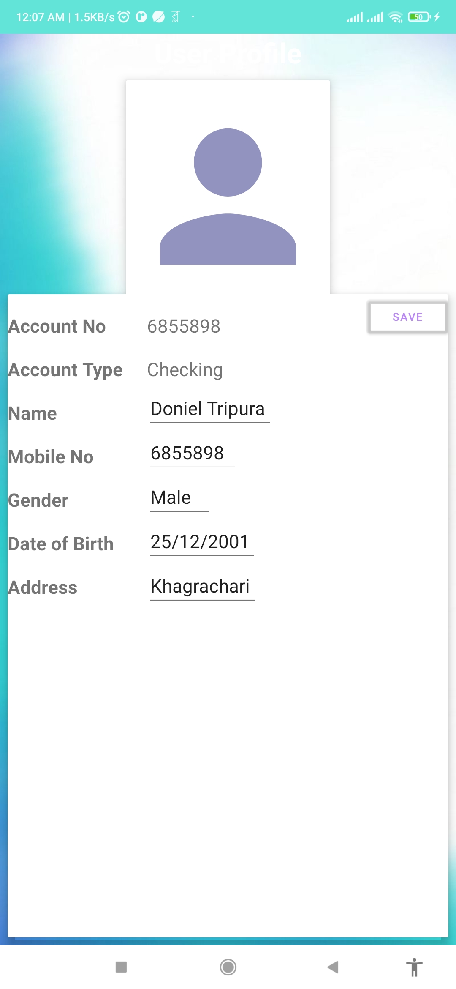
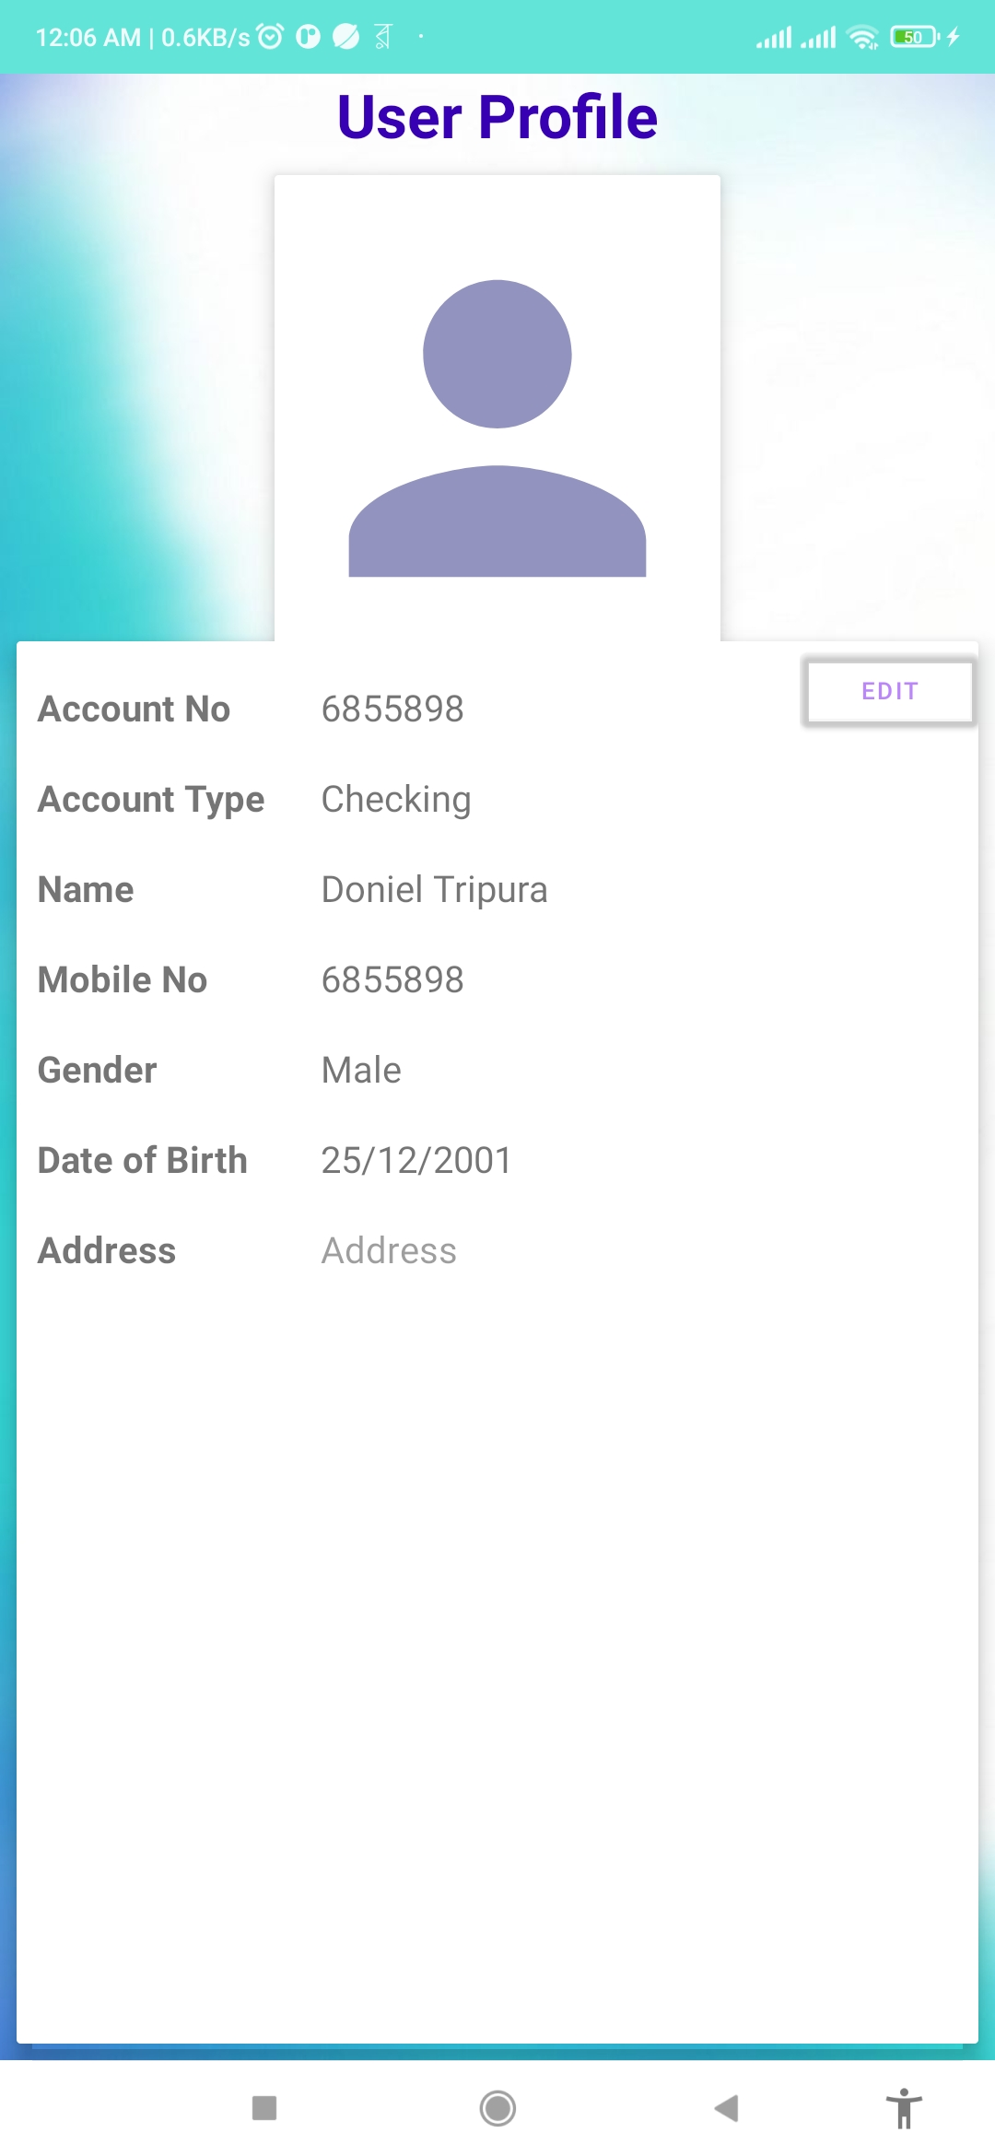
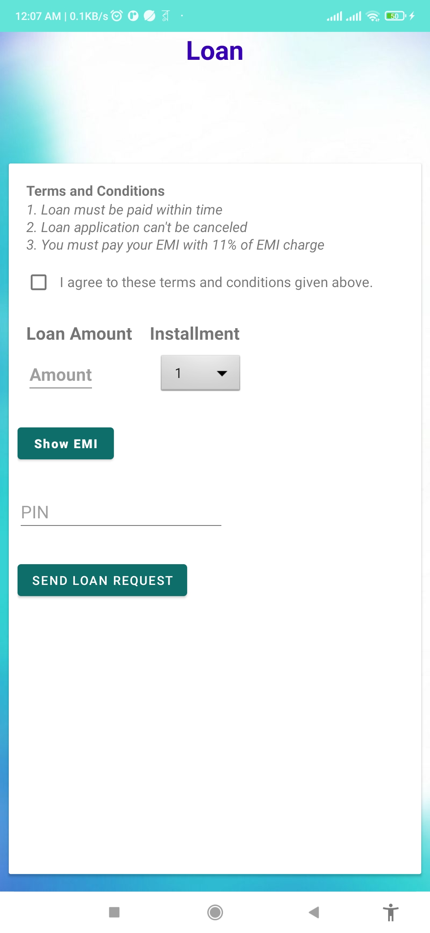
Visualization of Customer Panel

Slide 8
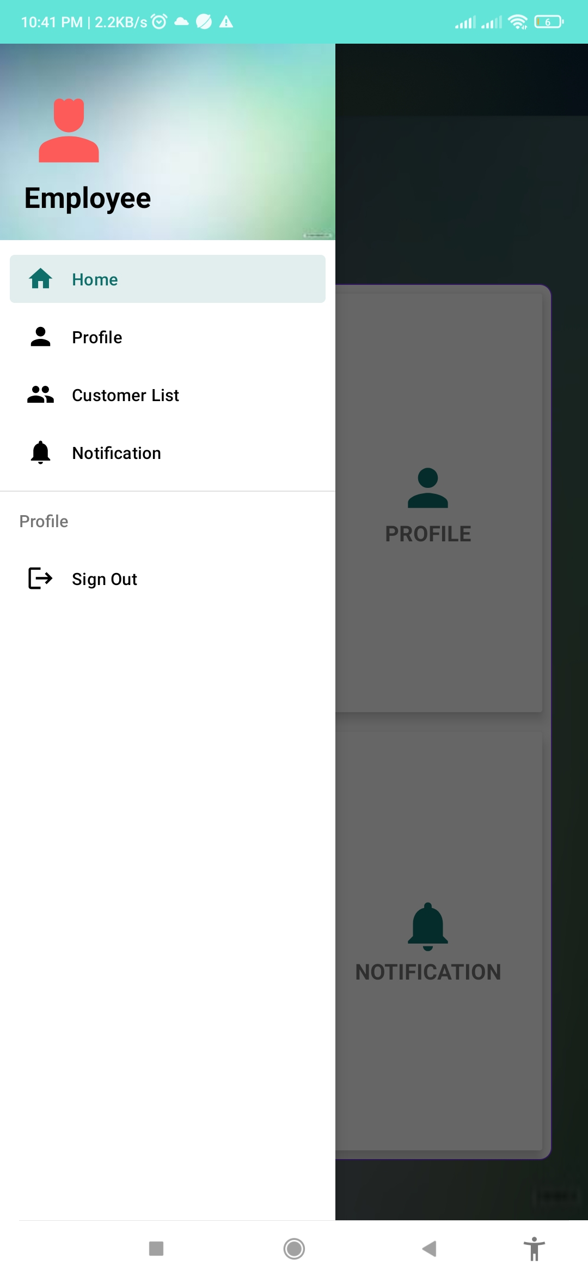
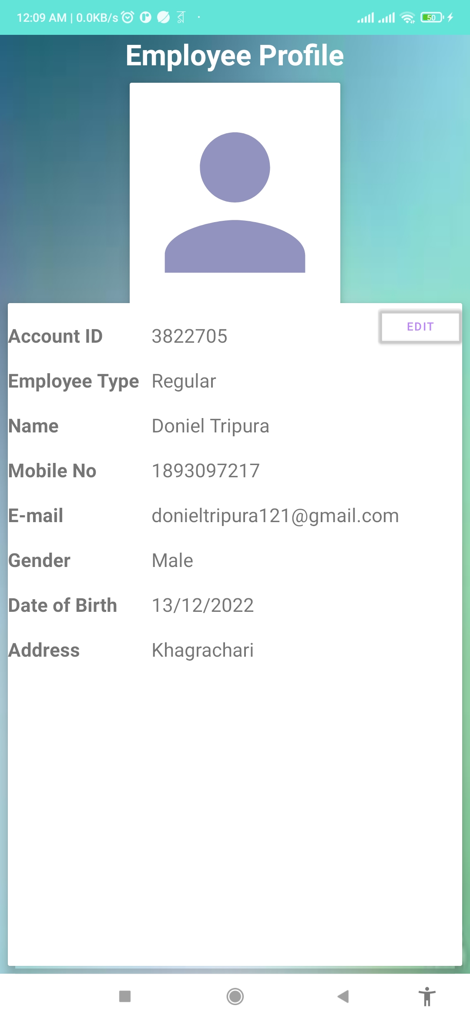
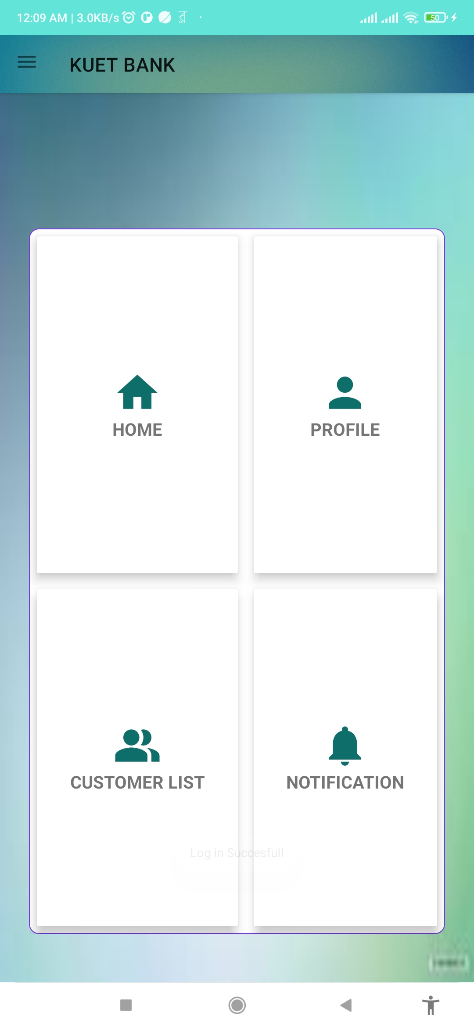
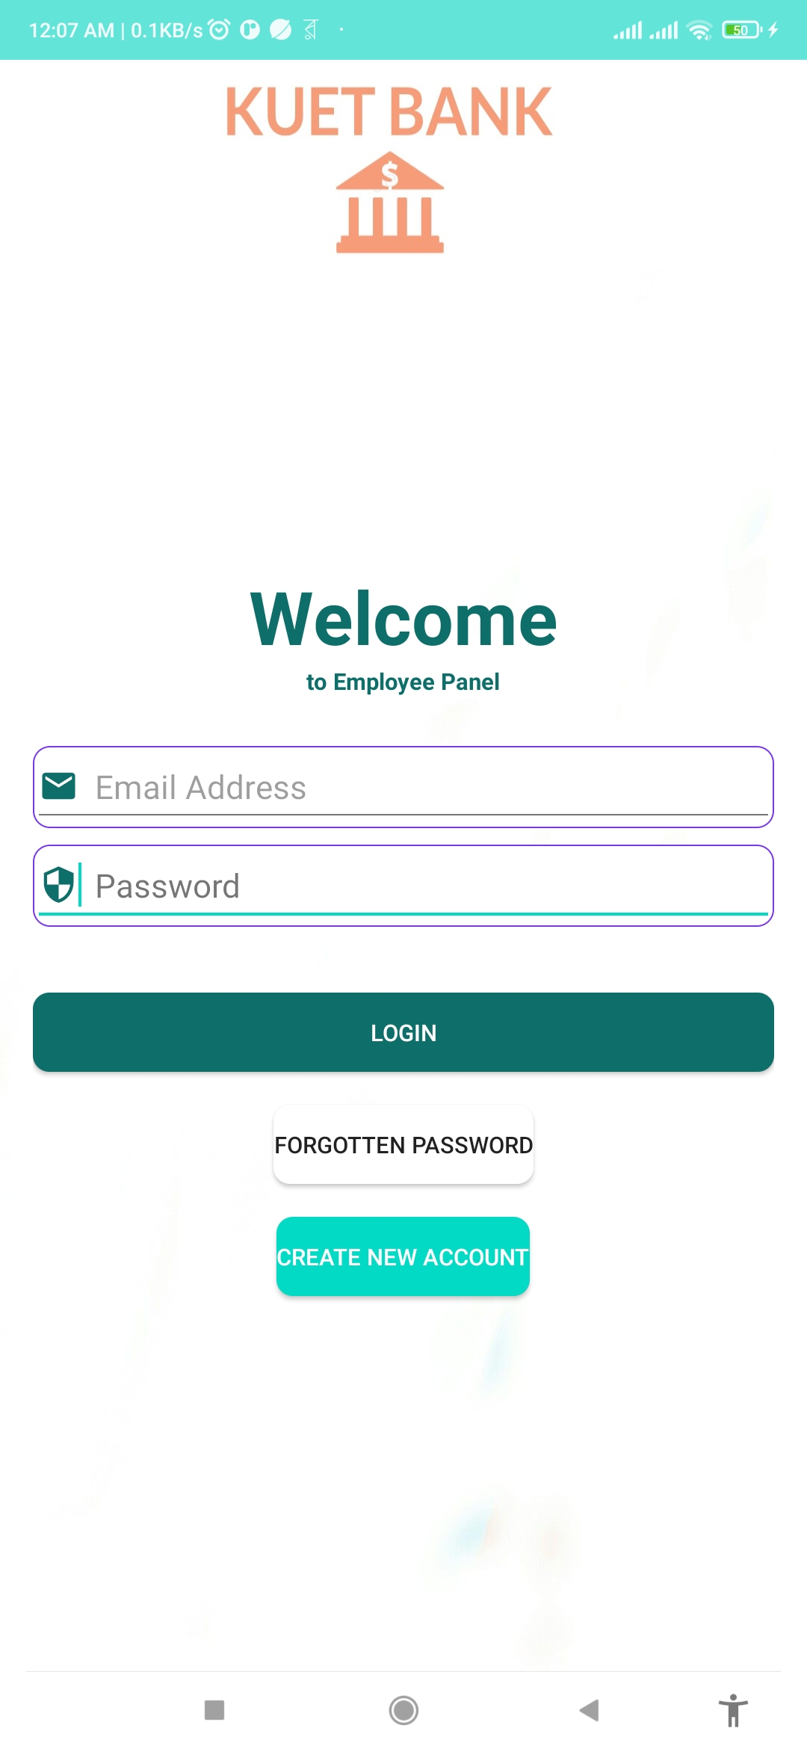
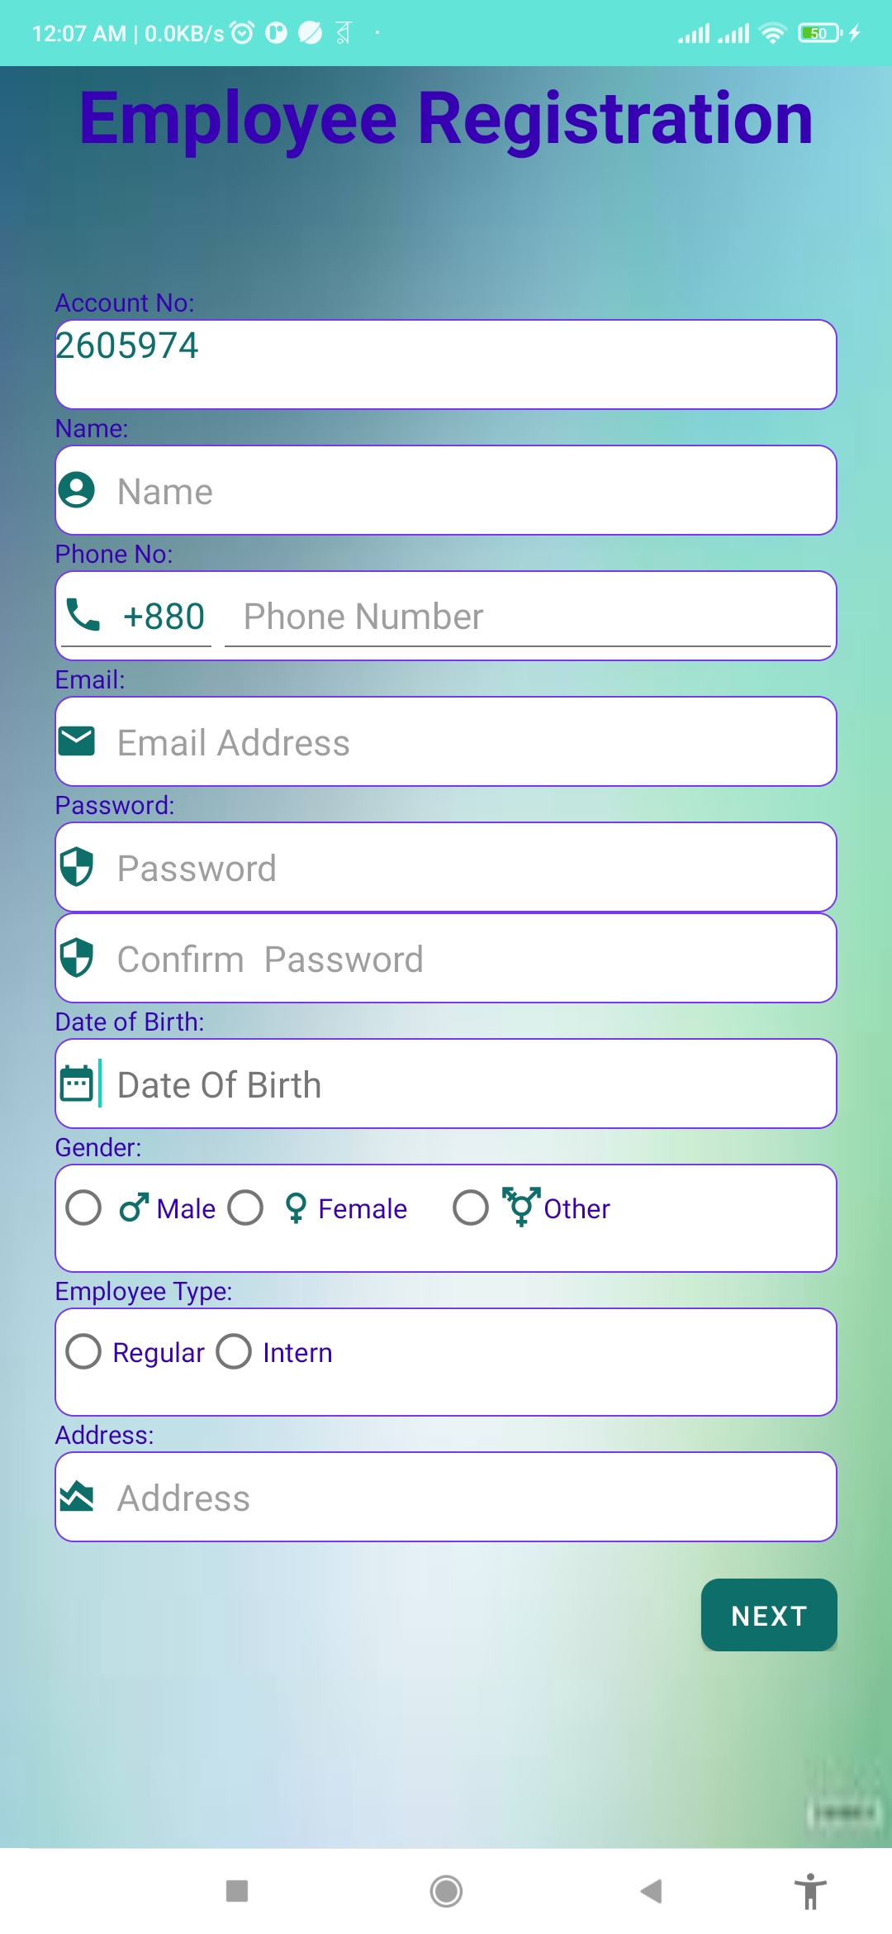
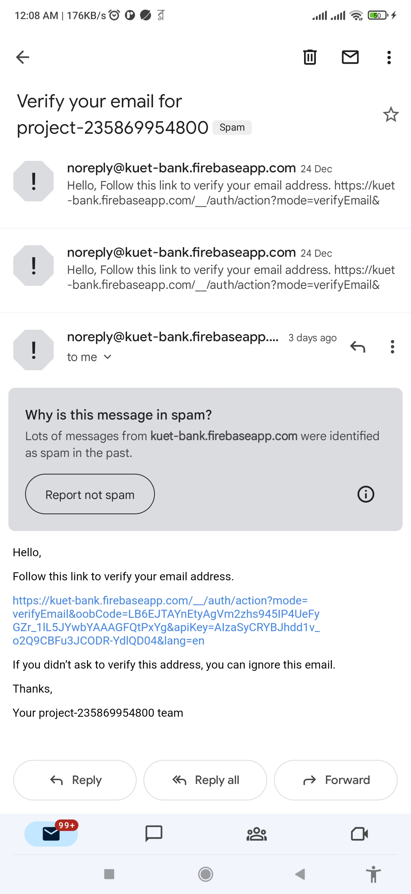
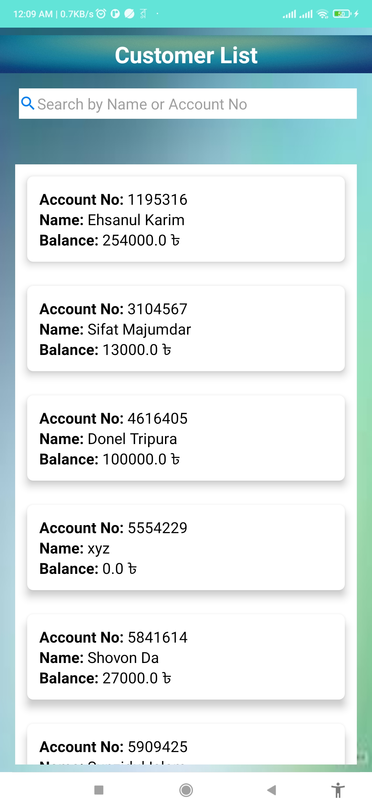
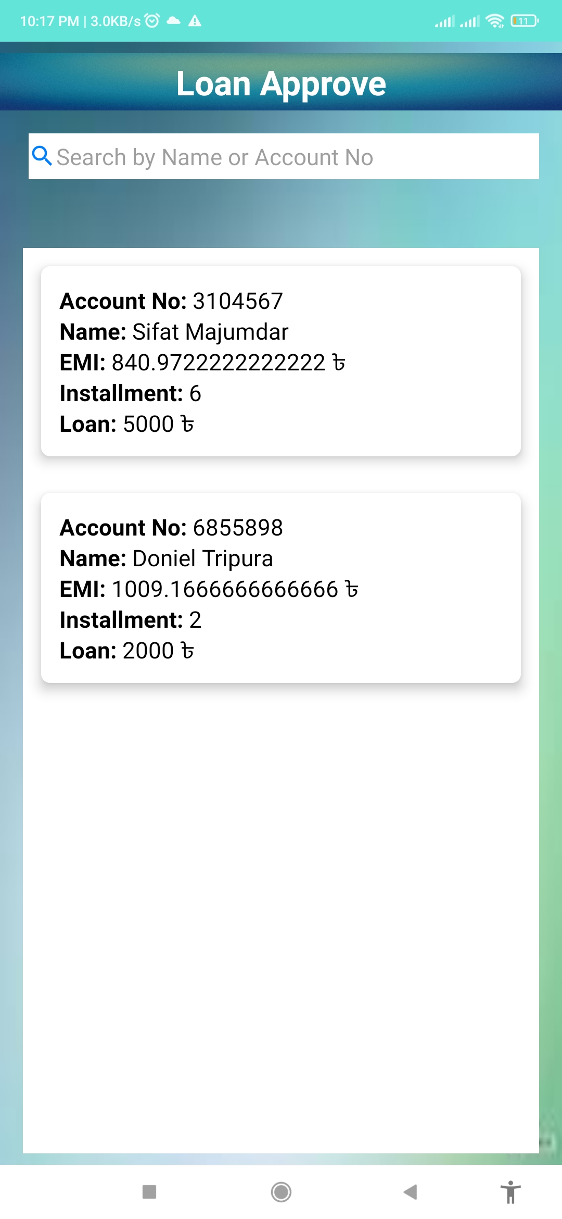
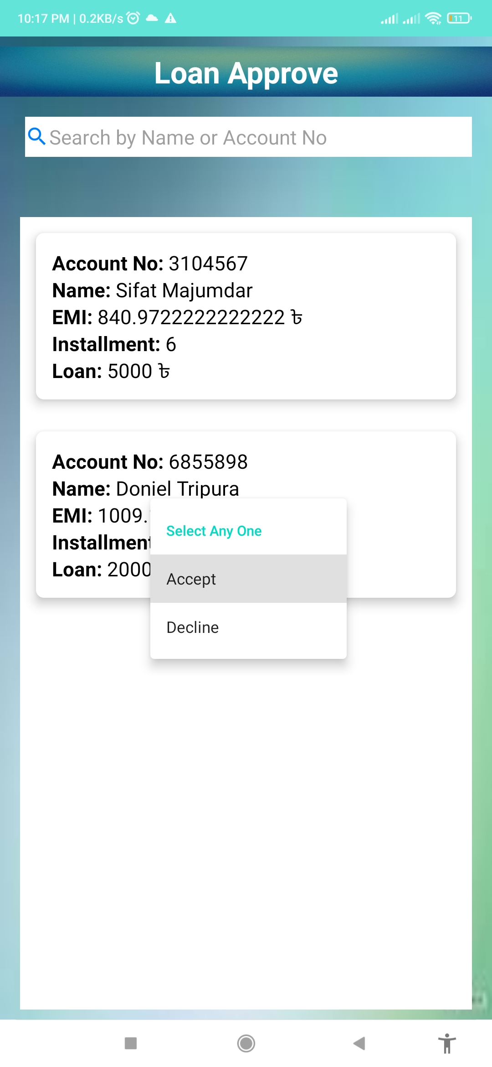
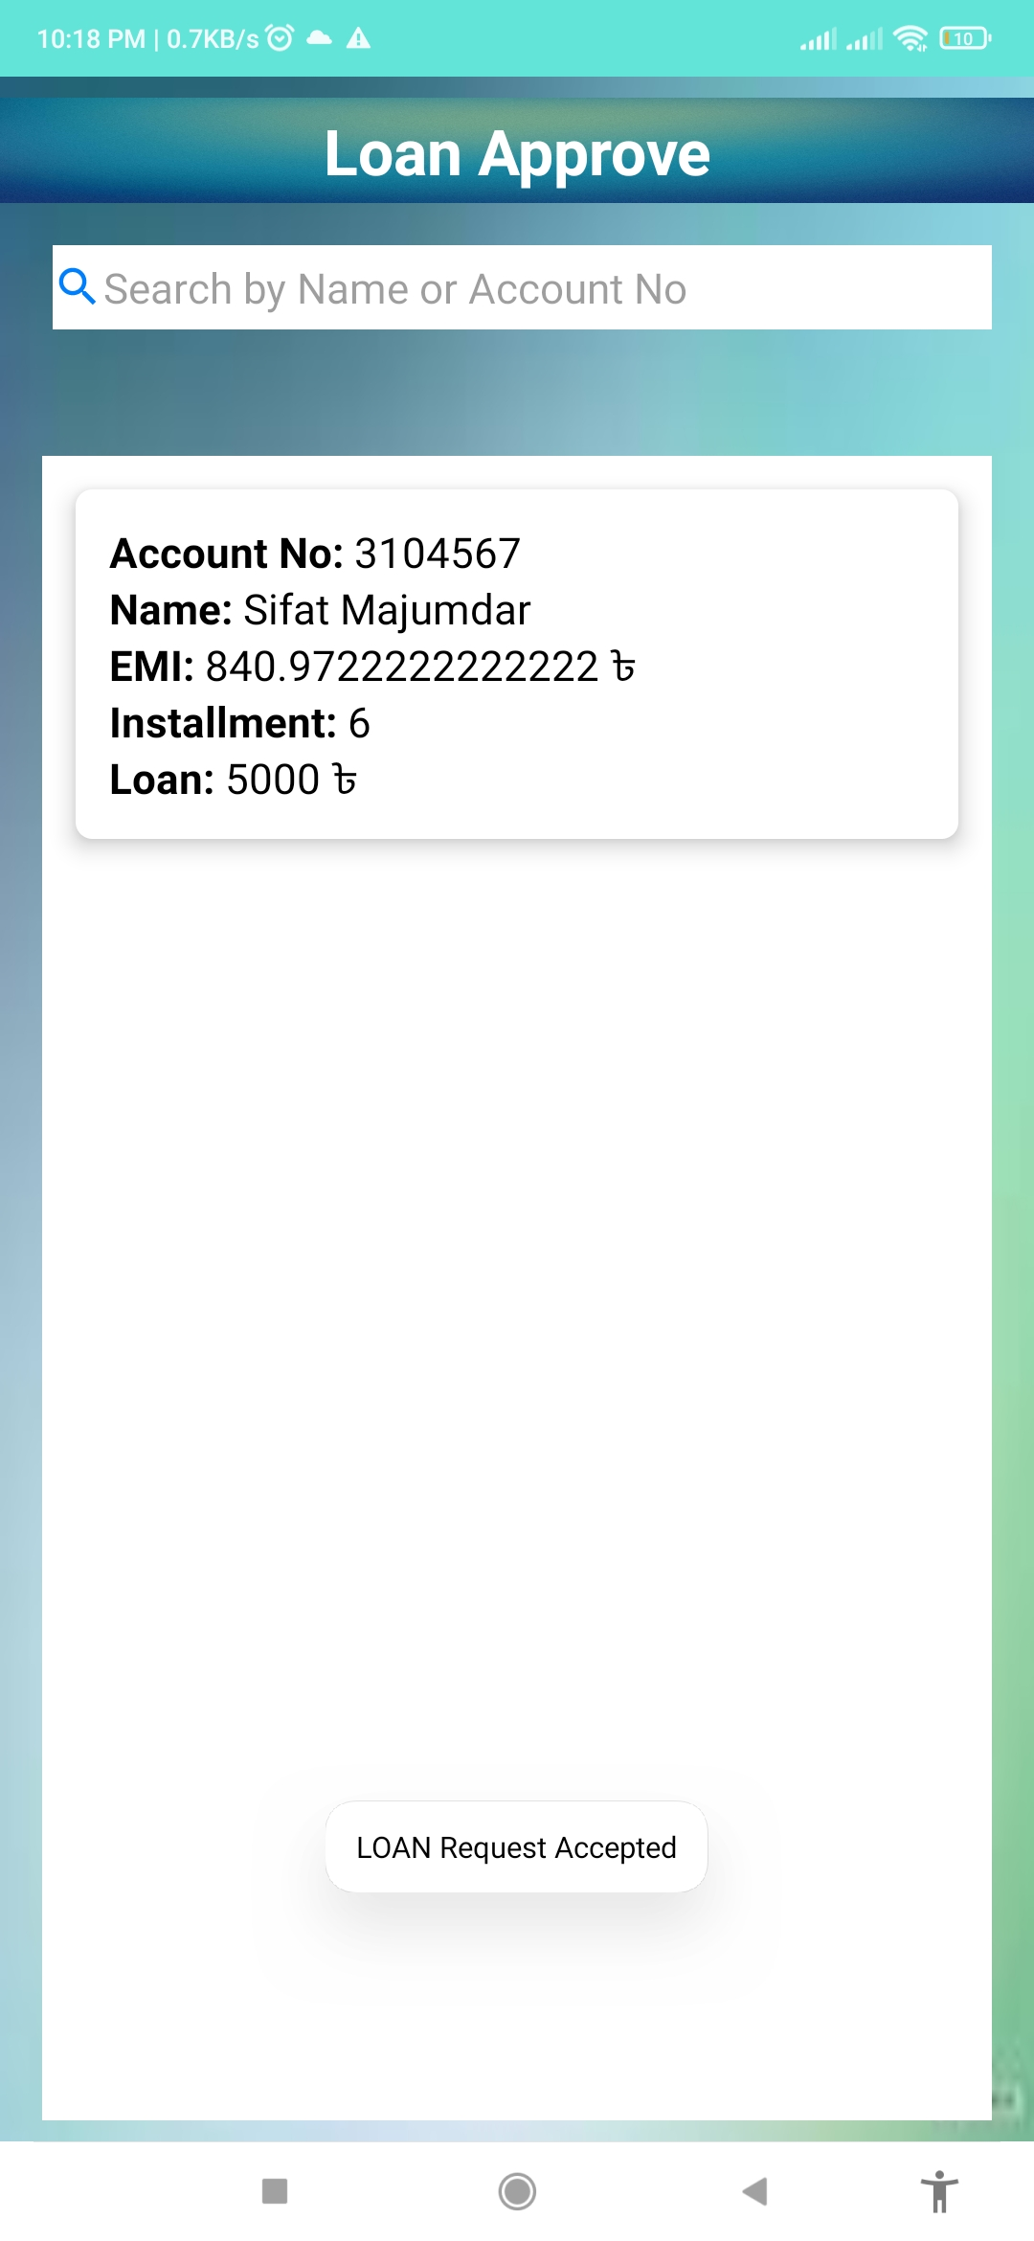
Visualization of Employee Panel

Slide 9
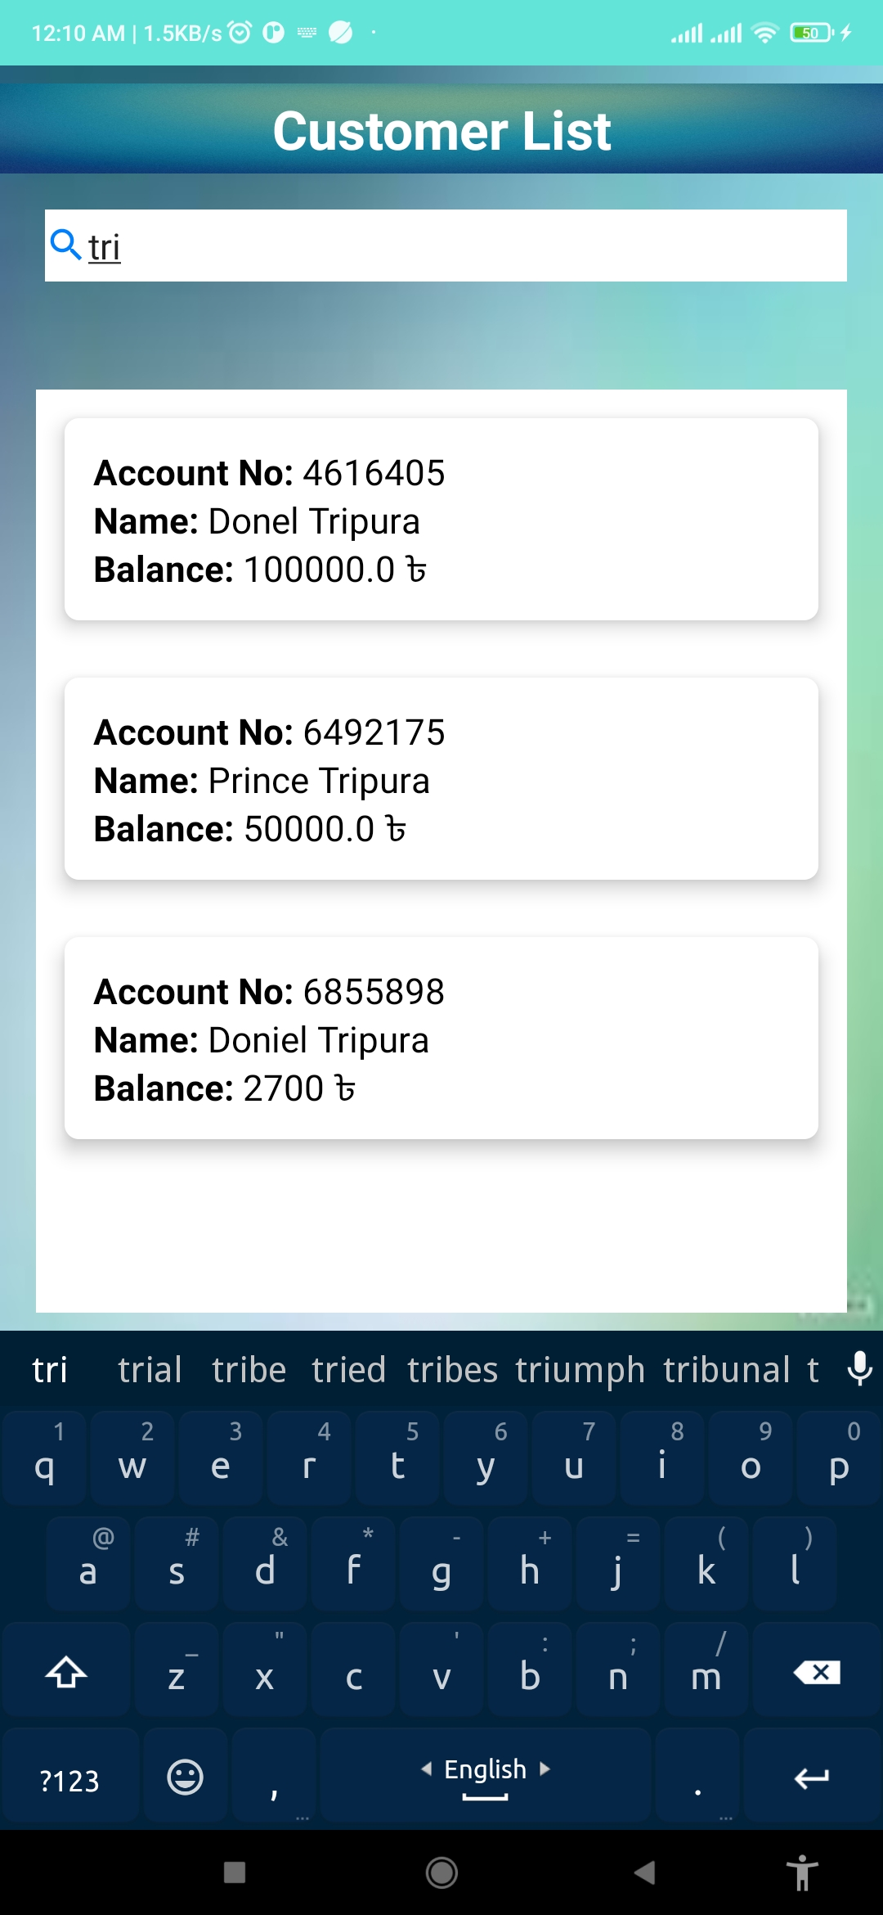
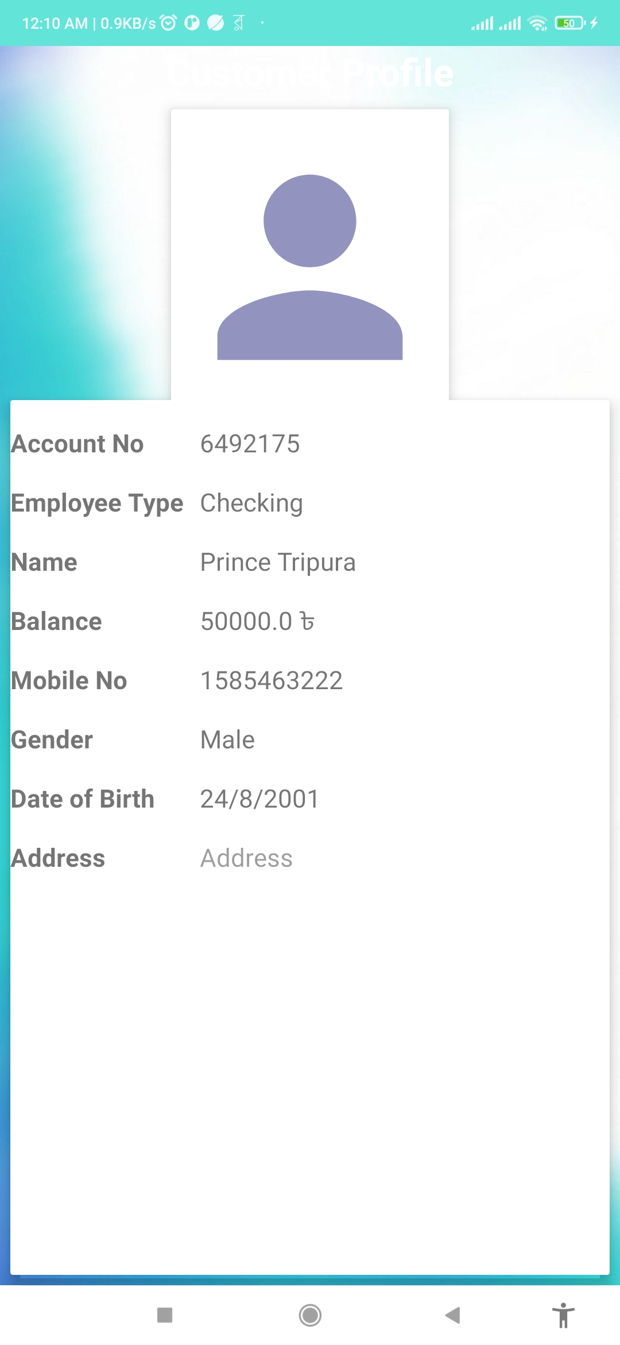
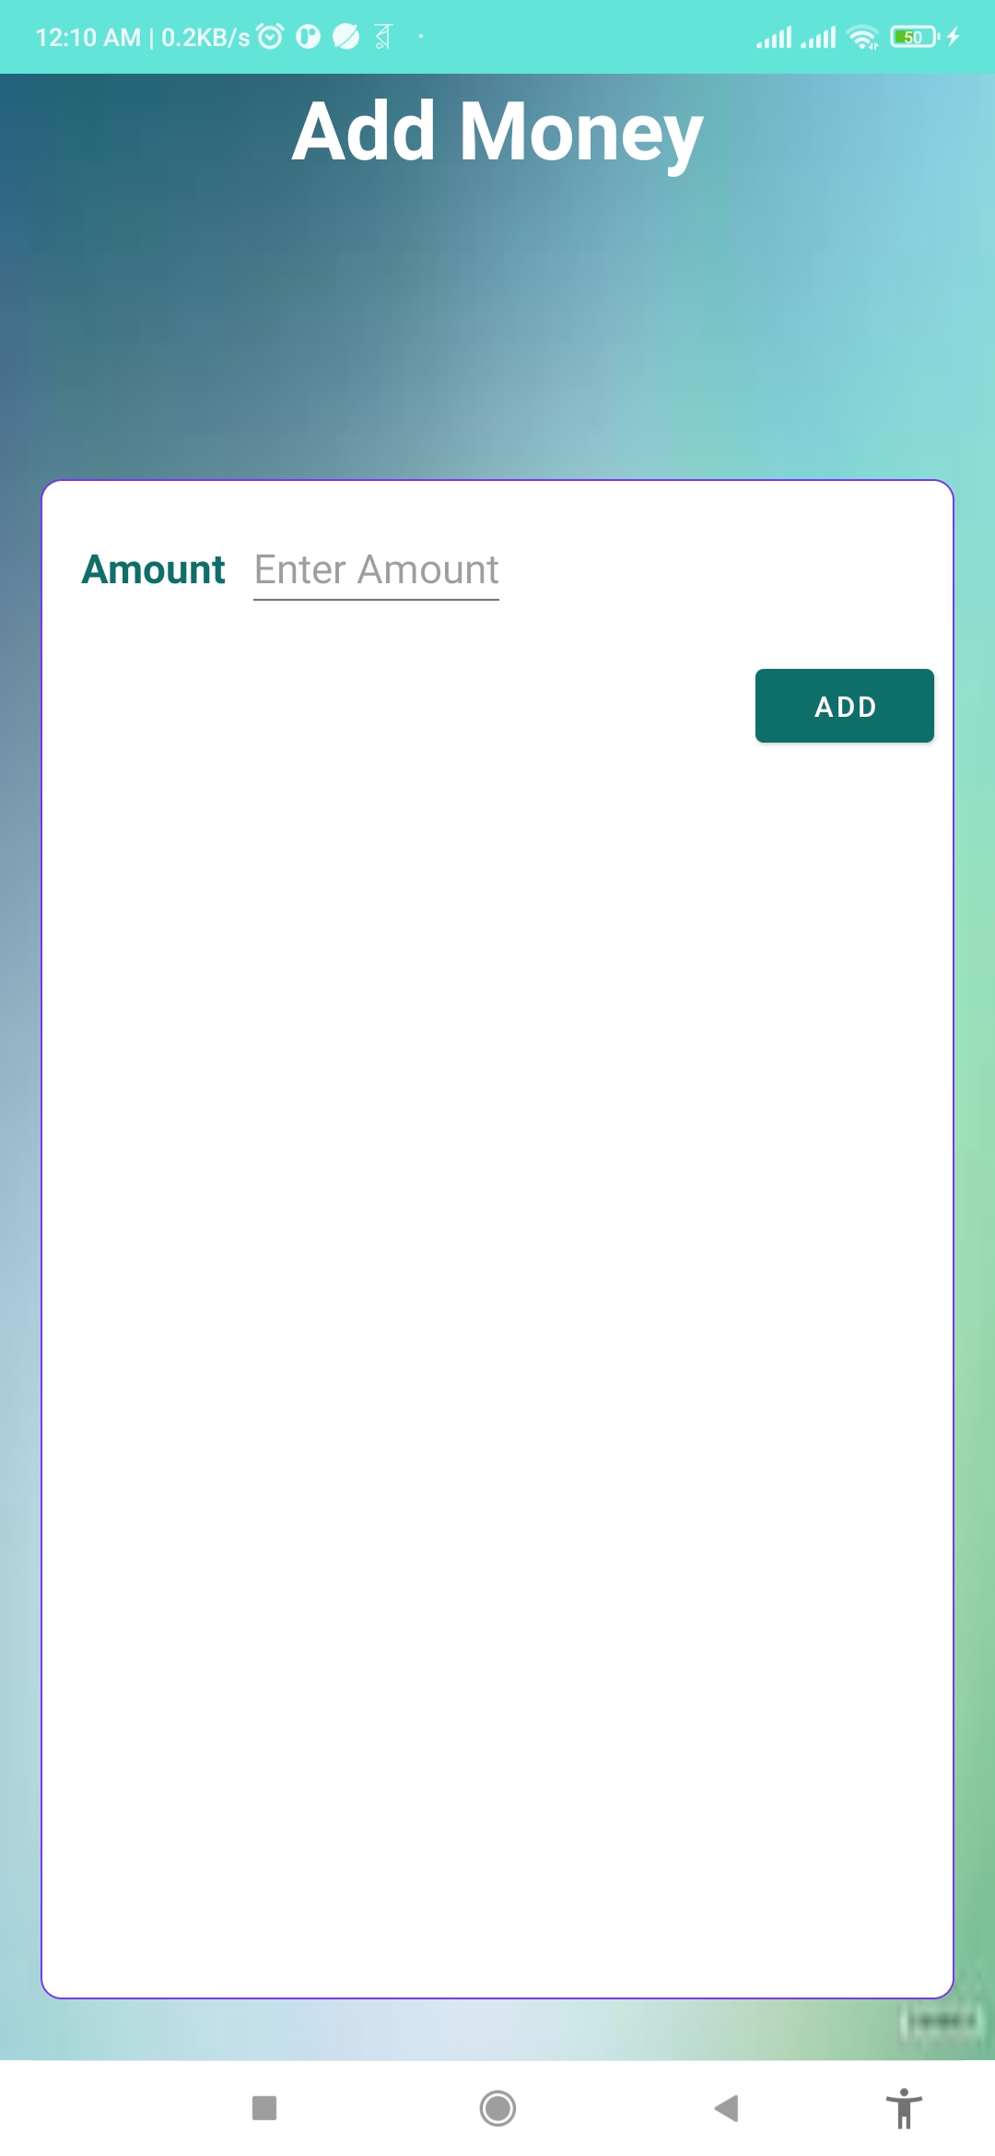
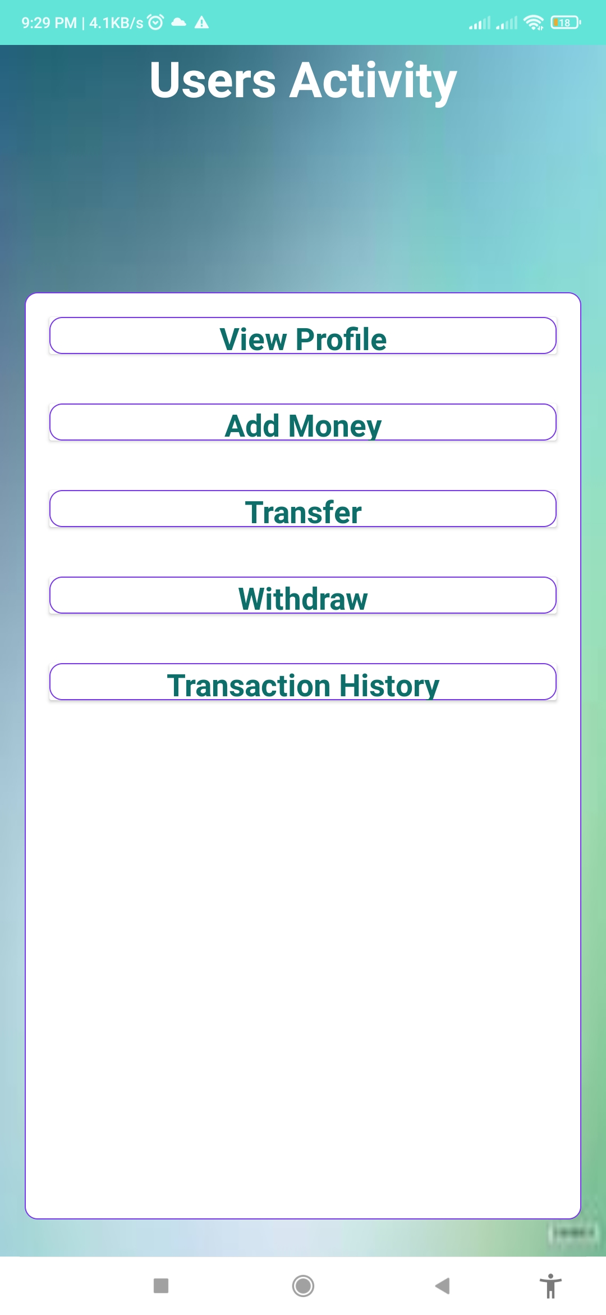
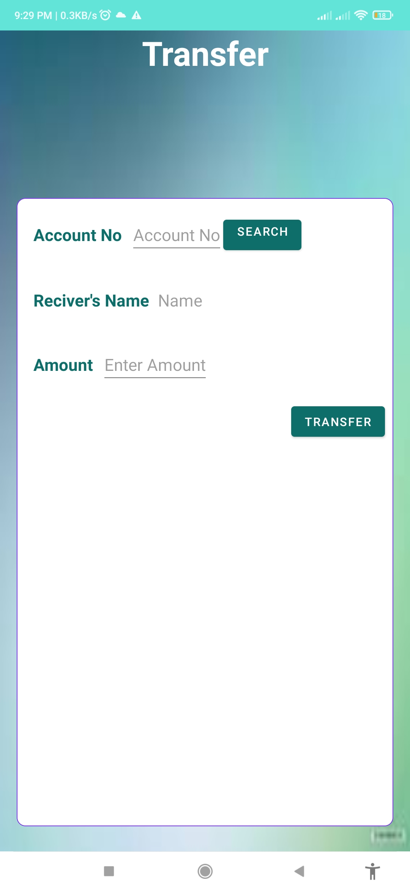
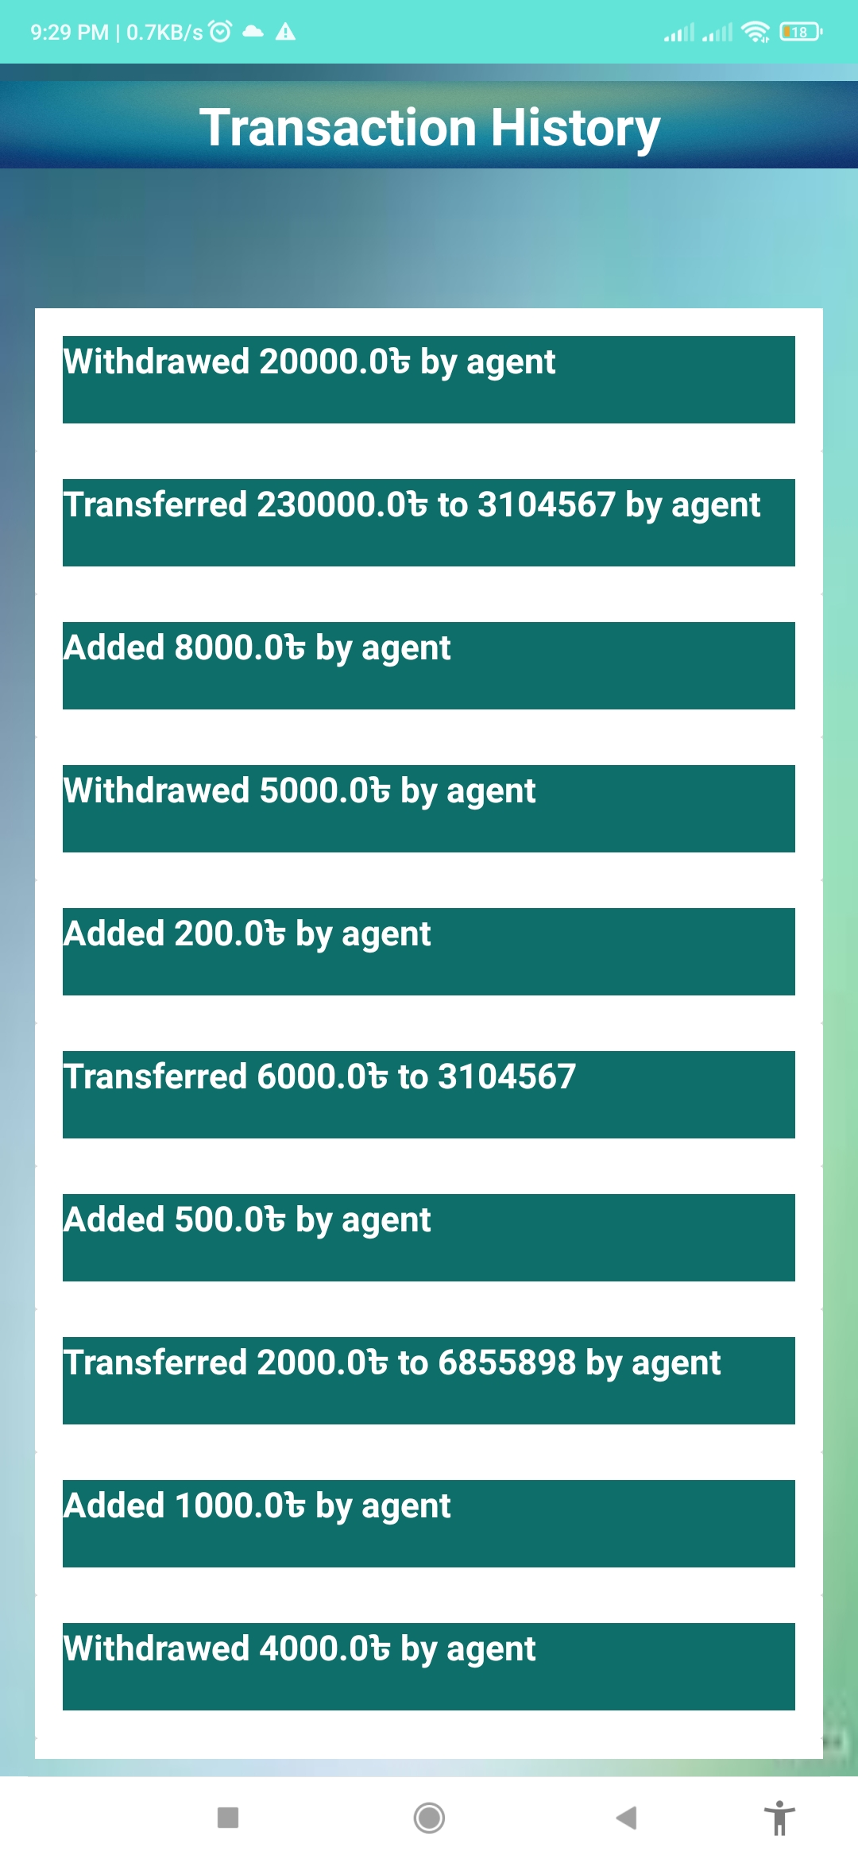
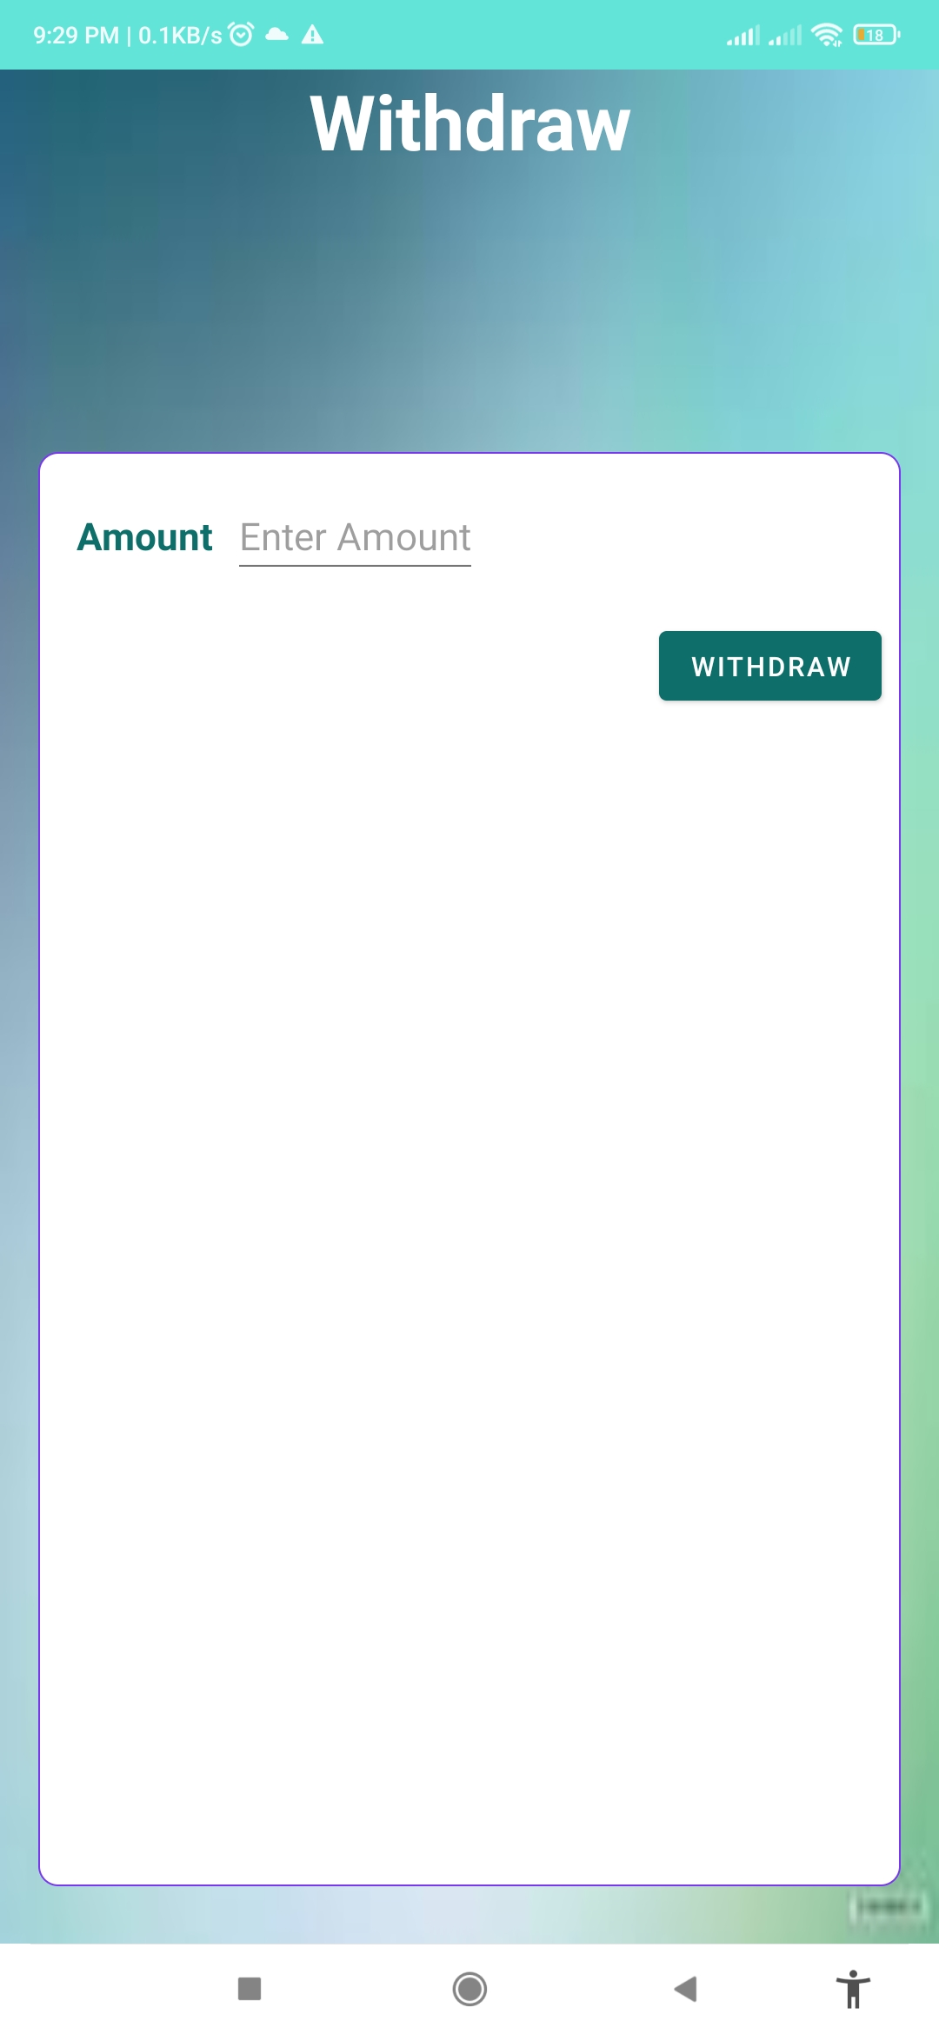
Visualization of Employee Panel

Slide 10
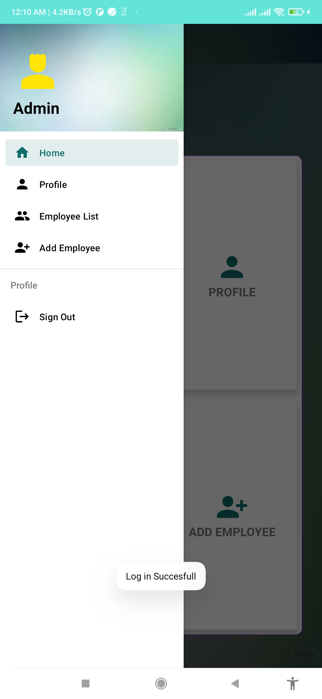
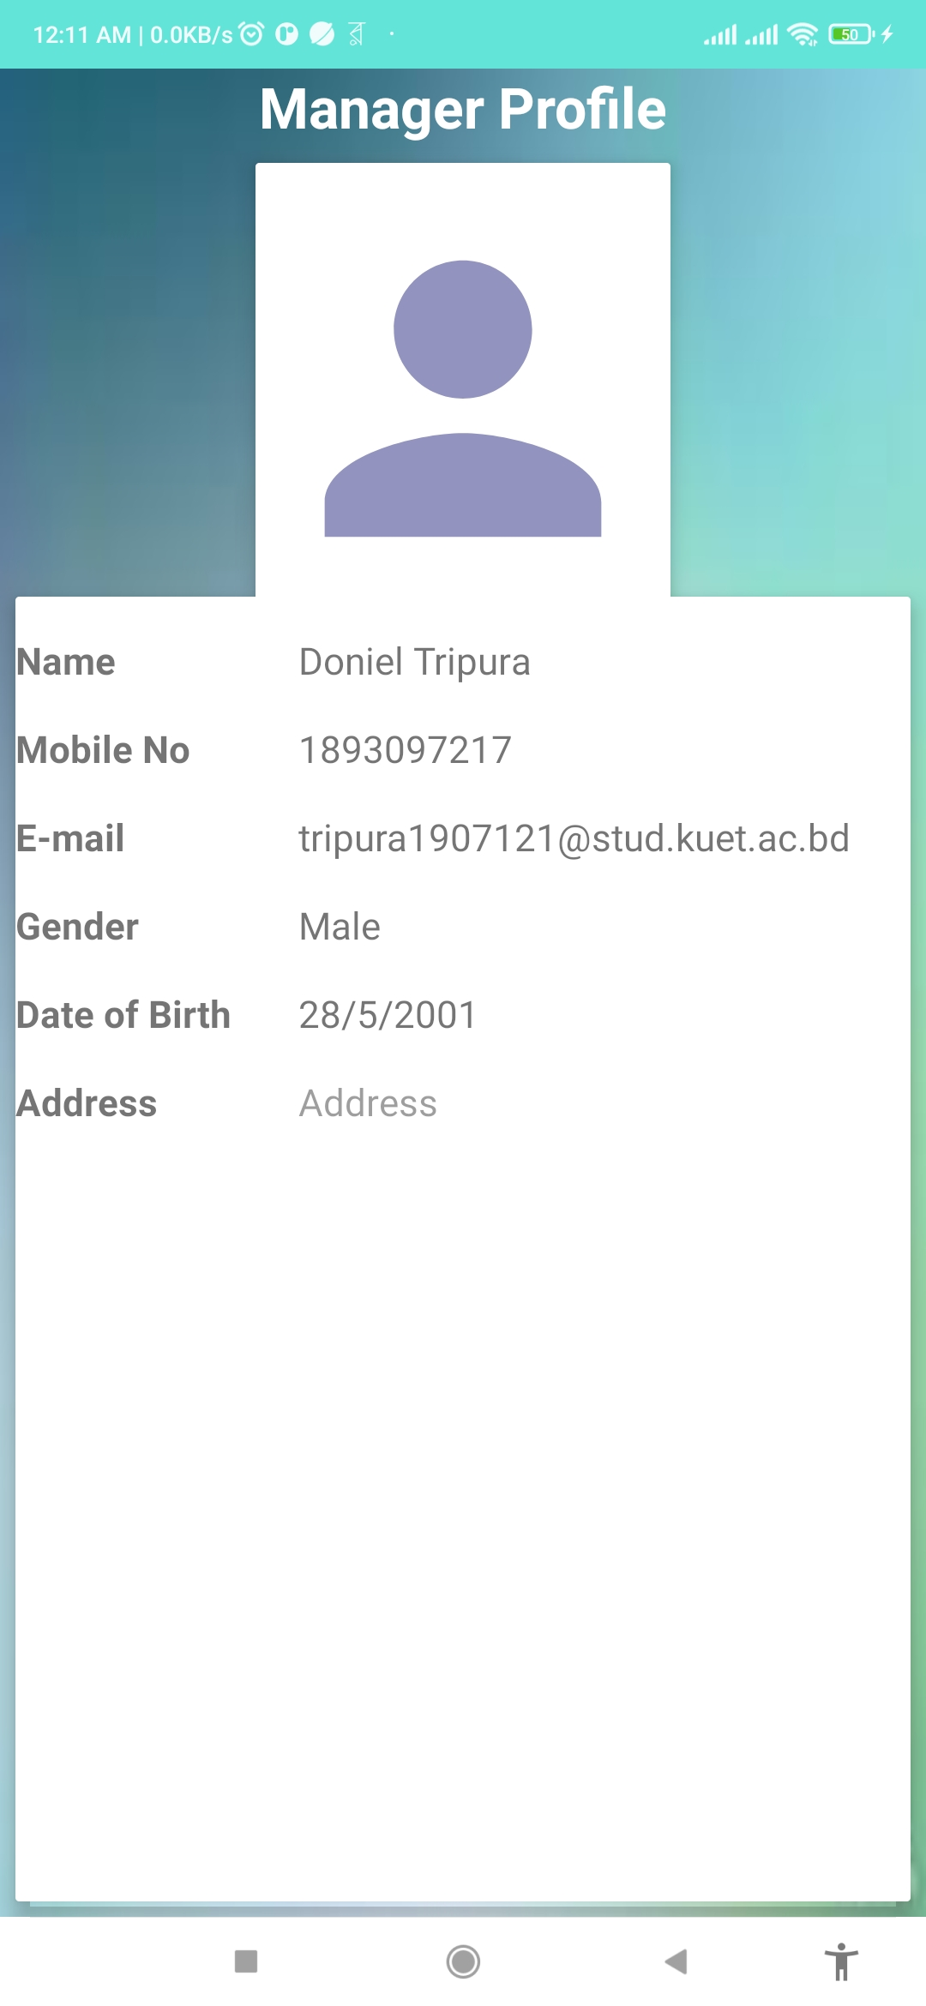
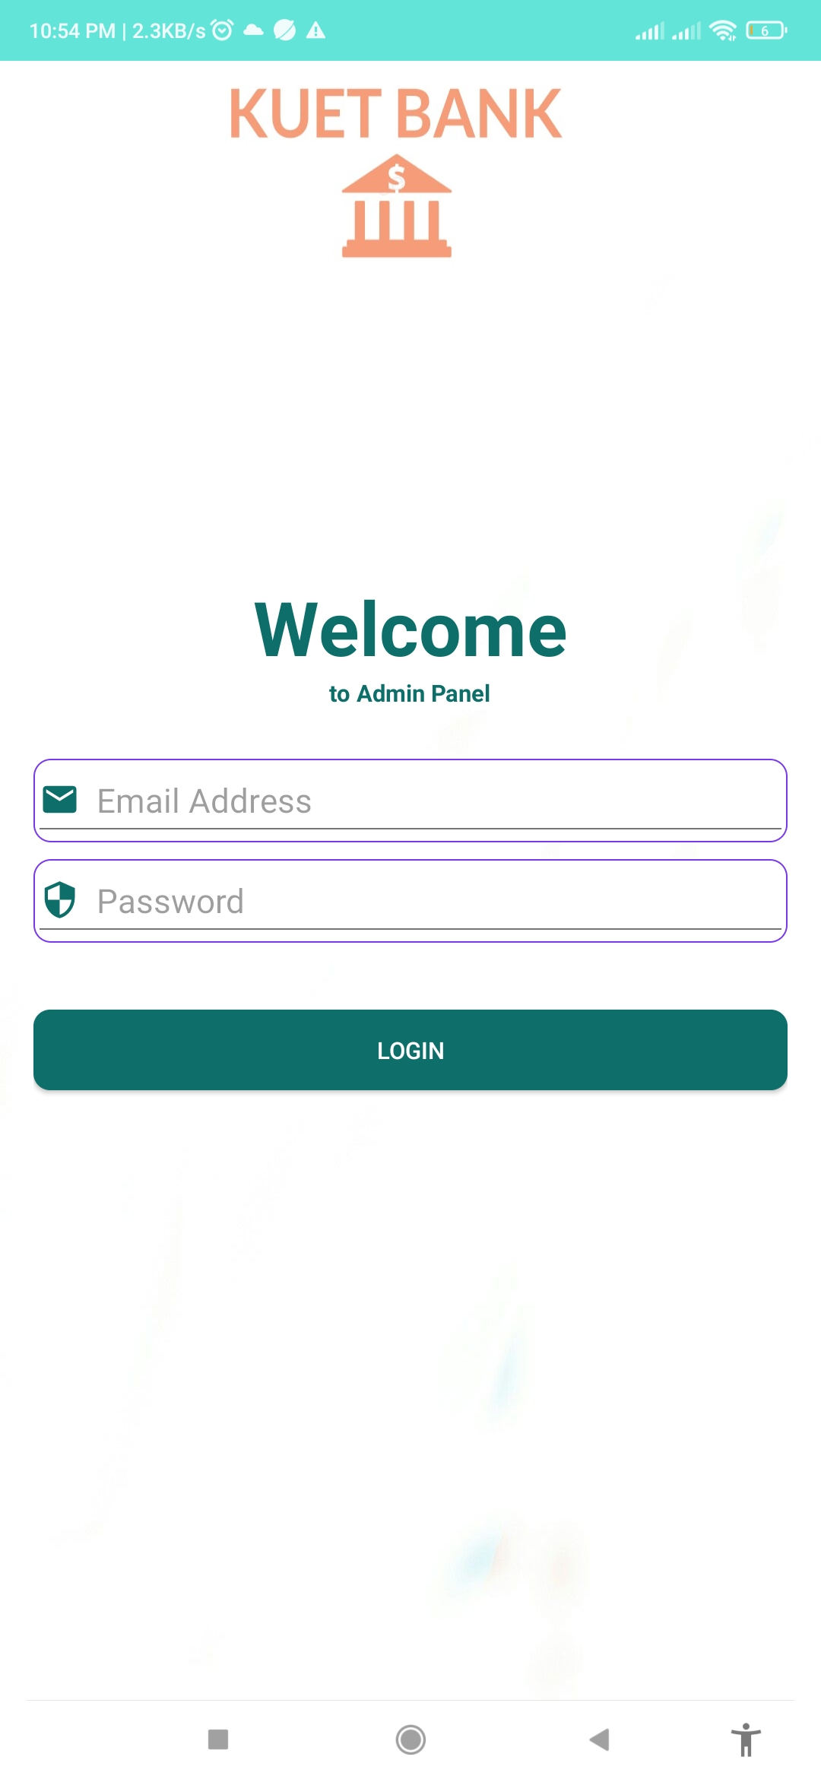
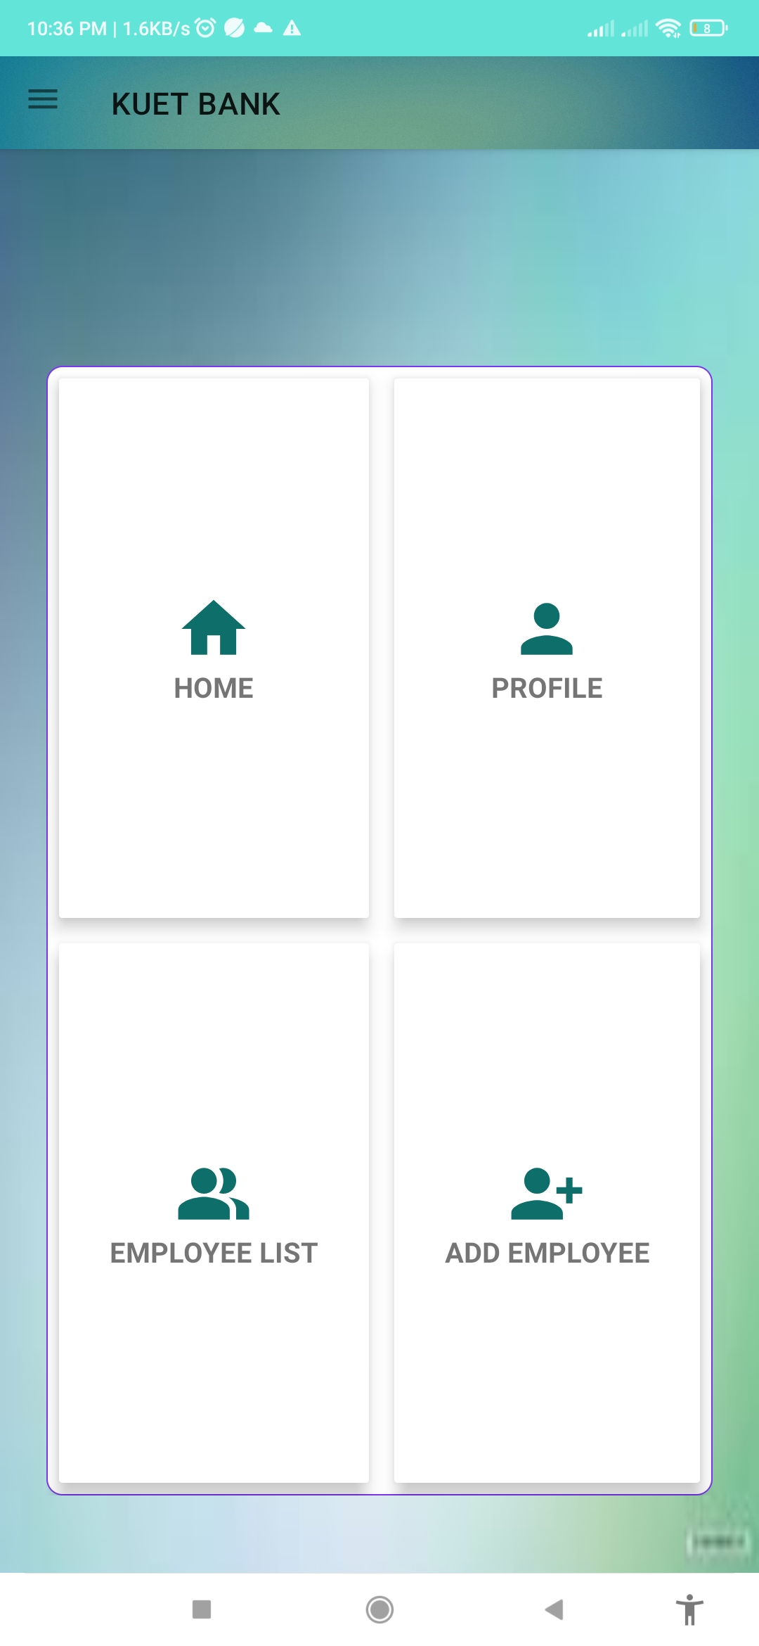
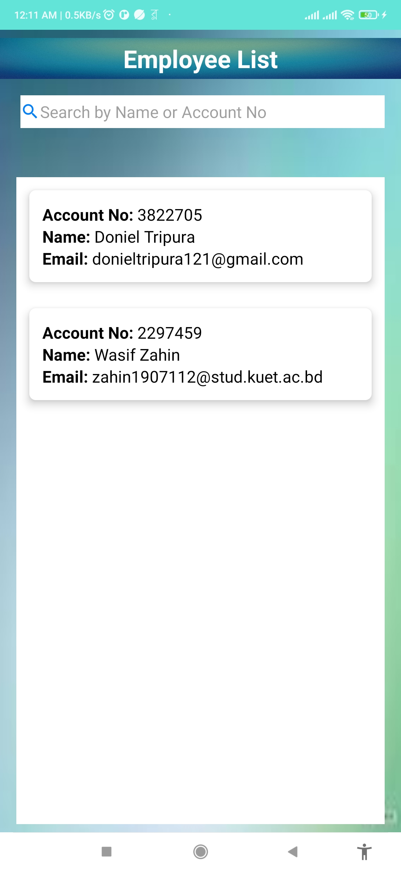
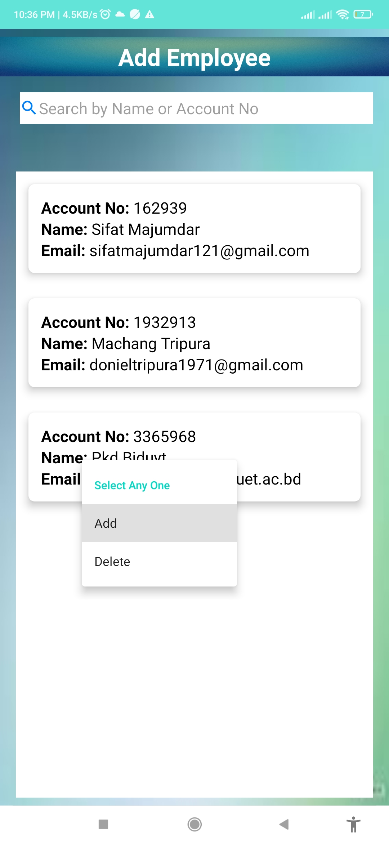
Visualization of Manager Panel

Slide 11
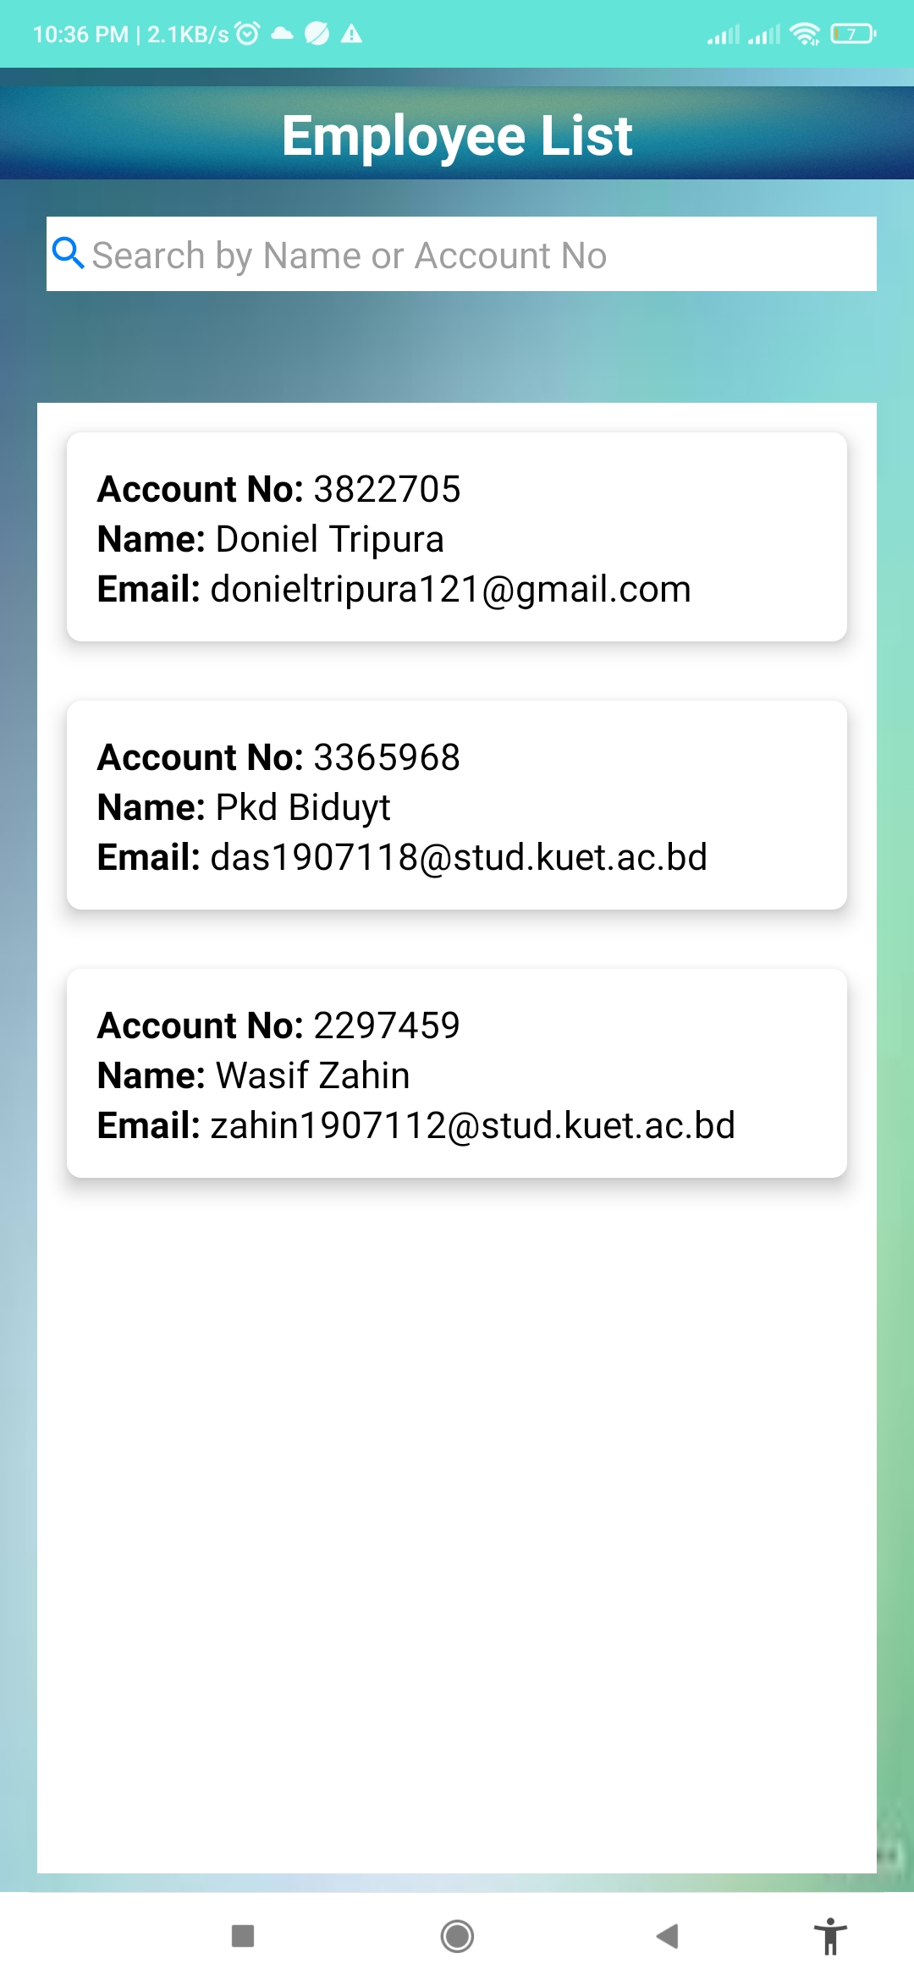
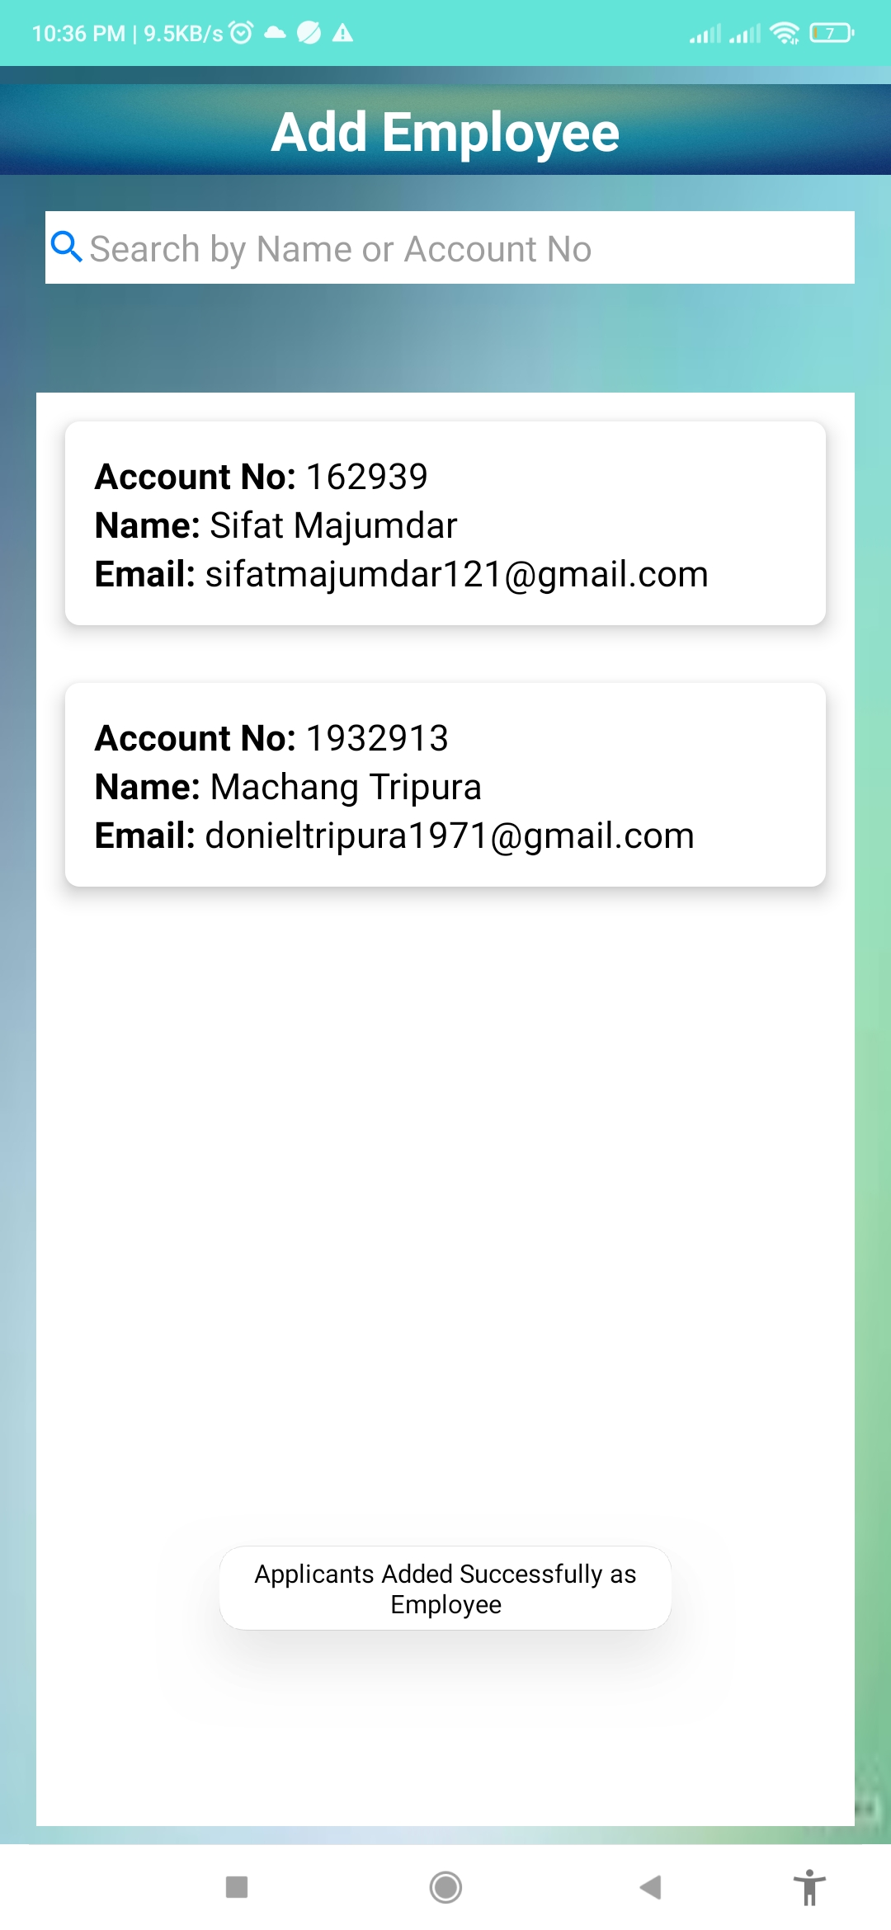
Visualization of Manager Panel

